Slide 1
Searching for Hidden Signals in the Pantheon+ and SH0ES samples
Leandros Perivolaropoulos
Department of Physics, University of Ioannina, Greece
CosmoVerse@Lisbon

Slide 2
Main Questions
Q1: Is the absolute magnitude parameter M used for fitting with Pantheon+ homogeneous?
A1: No. The data favor a change of this parameter at about 20Mpc
Q2: Is the absolute luminosity of SnIa derived from the SH0ES data homogeneous across the sample?
A2: Maybe. There are hints at about 2σ for a change of this absolute luminosity at about 20-25Mpc.
Q3: Are the Pantheon+ and SH0ES data at various redshift bins consistent with isotropic Monte-Carlo simumations?
A3: Yes. In fact in many bins they are more isotropic than the Monte-Carlo simulations. This may be due to overestimated uncertainties of the Pantheon+ magnitudes.
Q4: Are there unexpected changes of the anisotropy level between consecutive distance/redshift bins?
A4: Yes. Based on Monte-Carlo expectations, there is an unexpected rise and drop of the anisotropy at about 20-40Mpc.

Slide 3
Measuring H(z) with the 2022 Pantheon+ dataset
from SnIa in Cepheid hosts at z<0.01
1701 SnIa datapoints (z_{i},m_{Bi},μ_{Cephj}), i=1,…,1701, j=1,…,77, 0.001<z_{i},<2.26
Also provided μ_{SH0ESi}=m_{Bi}-M_{Cepheid}
Standard maximum likelihood of previous Pantheon sample (no μ_{Cephj})
Degeneracy between H₀ and M
(no way to fit H₀ without prior knowledge of M)

Slide 4
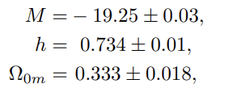
Measuring H(z) with the 2022 Pantheon+ dataset
Pantheon+ likelihood: Utilizing the 77 Cepheid distance moduli μ_{Cephj} of SnIa in Cepheid hosts:
Best fit parameter values:
Broken degeneracy between H₀ and M due to the 77 SnIa distance moduli in Cepheid hosts
A way to fit H₀ along with other cosmological parameters without prior knowledge of M!
Agreement with Brout et.al. 2022
Brout et al 2022: M not included in fit.

Slide 5
New degrees of freedom in the Pantheon+ likelihood
Allow for a transition of M
at some distance d_{c}
New likelihood for Patheon+:
Q:
1. What is the quality of fit of ΛCDM with the new likelihood?
2. Are the best fit M>, M< consistent with each other and with the best fit M of the standard likelihood

Slide 6
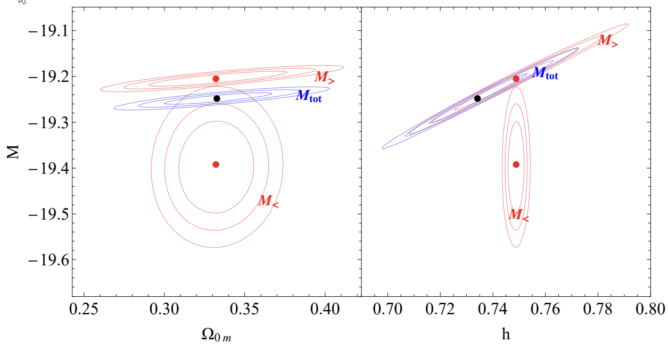
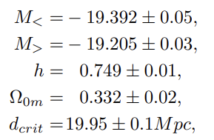
New degrees of freedom in the Pantheon+ likelihood
Q: Does this modeling of M<, M> affect the best fit values of other cosmological parameters?
Best fit Ω_{0m} remains unchanged in the new likelihood
h shifts to
somewhat higher values!
A₁: Δχ²=-19
Α₂:No! Significant tension!
Q: What is the origin of this tension? Systematics? New Physics? Both?

Slide 7
The volumetric redshift bias: A known but uncorrected systematic in Pantheon+
Δz> : Random peculiar velocities in outer shell compared to a given shell at redshift z.
If Δz> < 0 then the outer shell galaxies are incorrectly projected on the z shell leading to smaller distance estimate than the true distance d> .
d
Δz< : Random peculiar velocities in inner shell compared to a given shell at redshift z.
If Δz> > 0 then the outer shell galaxies are incorrectly projected on the z shell leading to larger distance estimate than the true distance d> .
d<
d>
Problem: There are more galaxies in the outer shell than in the inner shell due to larger volume of the outer shell!
More galaxies at higher distances are incorrectly projected to lower distance in the Hubble diagram due to peculiar velocities! Thus: d-d_{ΛCDM}(z)>0 for z<0.01 where the effect is important.

Slide 8
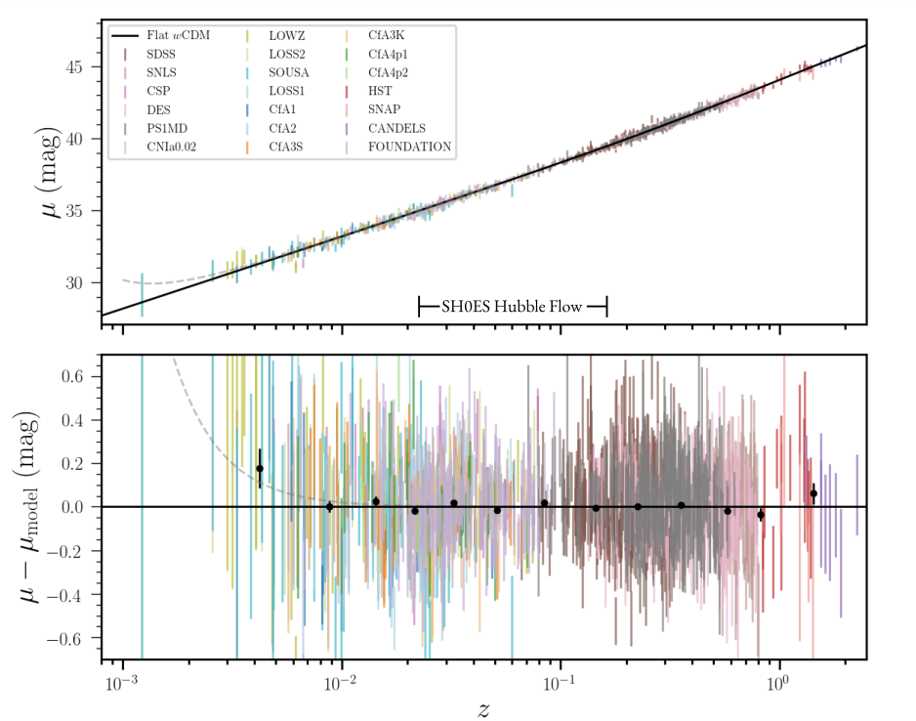
The volumetric redshift bias
The volumetric redshift bias is dominant at low redshifts where the volume difference is more prominent.
For z<0.01
μ<-μ_{model}(z)>0
m_{B<}-M<-μ_{model}^{vrb}(z) > m_{B<}-M-μ_{model}^{true}(z) = 0
μ_{model}^{vrb}(z)=μ_{model}^{true}(z)
M<<M=M>
If volumetric redshift bias is not corrected it leads to a lower SnIa absolute magnitude at z<0.01
m_{B<}-M>-μ_{model}^{vrb}(z;p) = 0
Incorrect value for p.
For z>0.01 (no vrb): m_{B>}-μ_{model}(z)=M>
Q: Is this the only reason for the M>-M< inconsistency or there is also a physical transition
of SnIa luminosity?
Thus, we expect: M>>M<

Slide 9
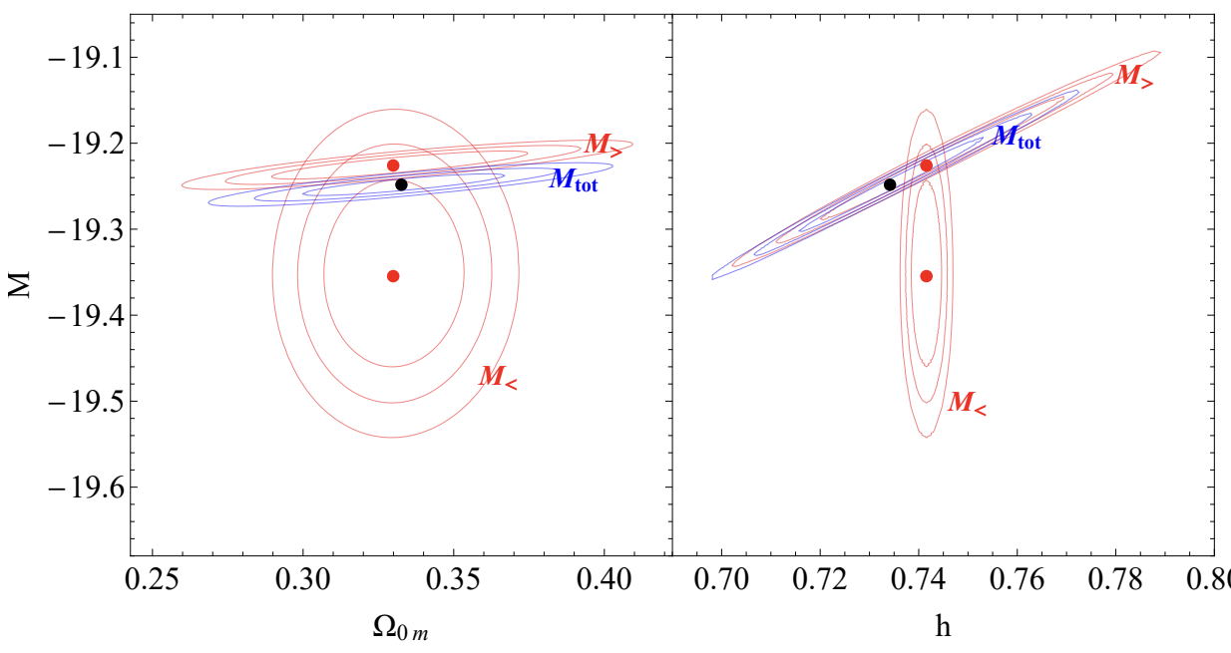
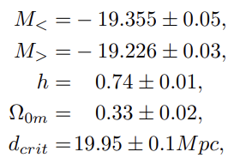
Another new likelihood for Pantheon+
Remove Hubble diagram distance moduli data with z<0.01 but keep distance moduli data of SnIa in Cepheid hosts.
The tension between M< and M> is smaller but a significant part of it remains

Slide 10
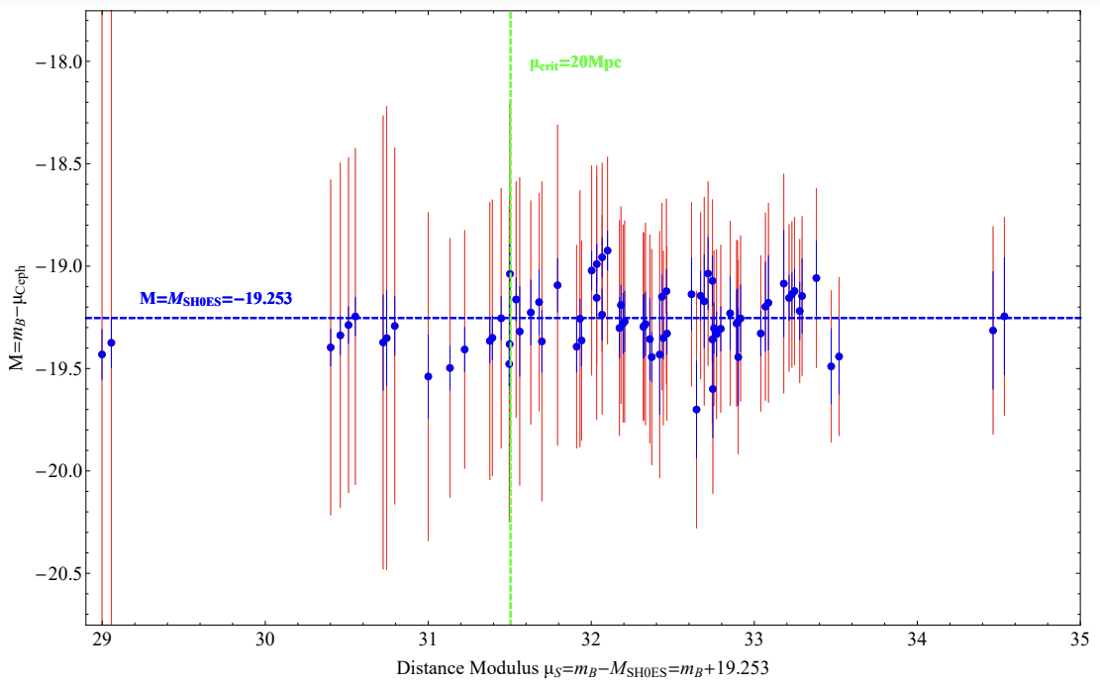
SnIa luminosities in Pantheon+
Closeby SnIa (d<d_{c}=20Mpc)
in Cepheid hosts
are systematically brighter more distant SnIa
(M<M_{SH0ES}=M_{best-fit})
Q: How often could this happen by chance?

Slide 11
Monte Carlo Simulation
Steps:
1. Group SnIa that are in the same host and find the weighted mean absolute magnitude corresponding to each j host:
2. For a critical distance d_{c} split the host absolute magnitudes in low distance and high distance bins e.g.
3. For each critical distance d_{crit}, define the M transition statistic:
4. In the real data we have Σ_{max} = 2.75, at d_{crit}=22.4Mpc.
Q: How often would a larger Σ_{max} occur in Monte Carlo simulated SH0ES/Pantheon+ SnIa in Cepheid host data?

Slide 12
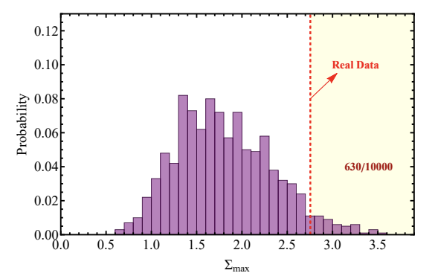
Monte Carlo Simulation
A: 94% of the simulated datasets have Σ_{max} smaller than the Σ_{max} of the real data and only about 6% have Σ_{max} larger than the real data.
Thus, the part of the M<-M> inconsistency that is due to actual SnIa luminosity mismatch is at about 2σ level.

Slide 13
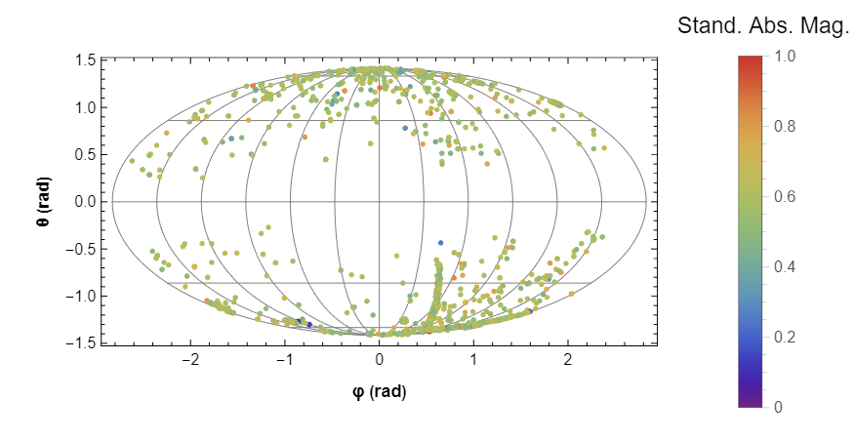
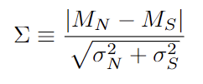
Hemisphere Comparison Method: Isotropy of SnIa Absolute Magnitudes
1. Select random direction and split sky in North-South hemispheres in given redshift bin.
2. Find weighted average of absolute magnitudes in each hemisphere (M_{N}, M_{S}) and their uncertainties.
3. Define anisotropy level statistic:
4. Find direction of maximum anisotropy level Σ_{max} .
Standardized SnIa absolute magnitudes
of Pantheon+.
5. Repeat for N isotropic Monte-Carlo samples to find anticipated range of Σ_{max}.

Slide 14
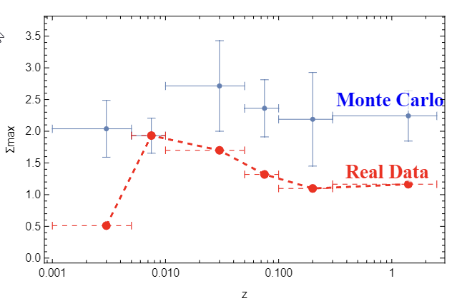
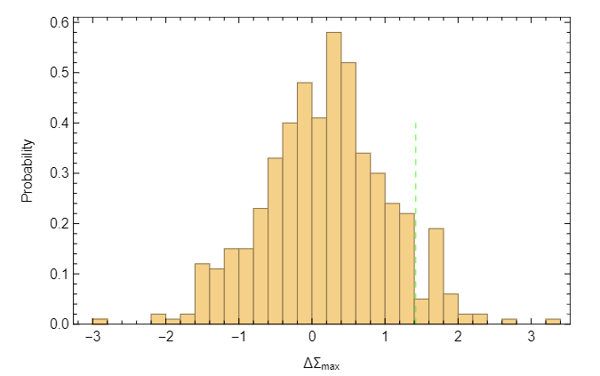
Comparison of Pantheon+ M-anisotropy with isotropic Monte-Carlo samples.
How frequent are these changes in Monte-Carlo isotropc data?
7%
Monte-Carlo simulated data are more anisotropic than real data (overestimated uncertainties?)
Real data
1->2 bin
Sudden changes appear of anisotropy level appear at low redshift bins

Slide 15
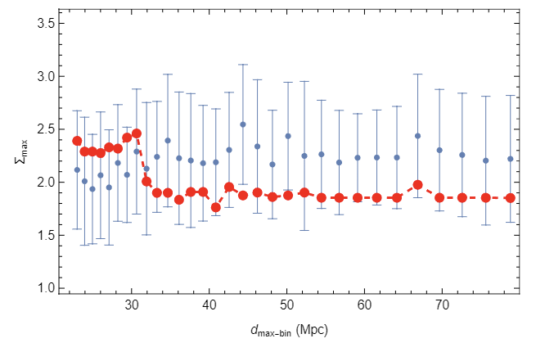
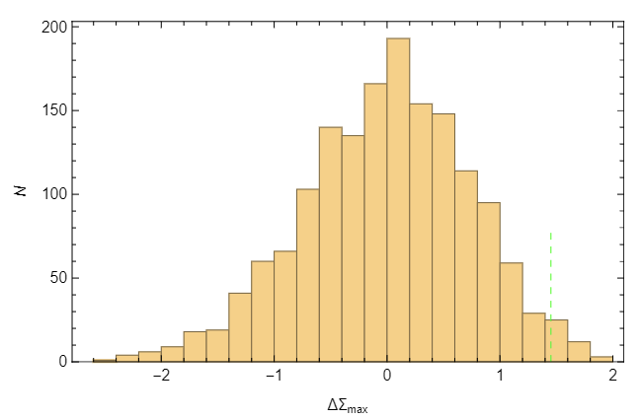
Comparison of SH0ES M-anisotropy with isotropic Monte-Carlo samples.
How frequent are these changes in Monte-Carlo isotropc data?
2%
Cumulative low distance bin
Real data
Sudden change appear in anisotropy level of cumulative bin appear at about 30Mpc

Slide 16
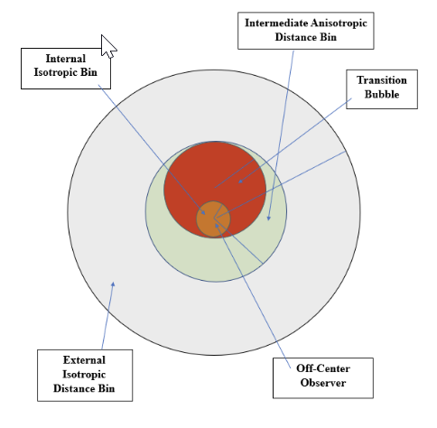
Possible Physical Realization
Off-center observer in a bubble of distinct transition physics
or
systematics

Slide 17
Main Questions
Q1: Is the absolute magnitude parameter M used for fitting with Pantheon+ homogeneous?
A1: No. The data favor a change of this parameter at about 20Mpc
Q2: Is the absolute luminosity of SnIa derived from the SH0ES data homogeneous across the sample?
A2: Maybe. There are hints at about 2σ for a change of this absolute luminosity at about 20-25Mpc.
Q3: Are the Pantheon+ and SH0ES data at various redshift bins consistent with isotropic Monte-Carlo simumations?
A3: Yes. In fact in many bins they are more isotropic than the Monte-Carlo simulations. This may be due to overestimated uncertainties of the Pantheon+ magnitudes.
Q4: Are there unexpected changes of the anisotropy level between consecutive distance/redshift bins?
A4: Yes. Based on Monte-Carlo expectations, there is an unexpected rise and drop of the anisotropy at about 25-40Mpc.

