Slide 1

Molecole Responsive e Smart Materials:
Dove e Perchè
Rosita Diana

Slide 2
Molecole Responsive
Smart Materials
Progettazione e Sintesi

Slide 3



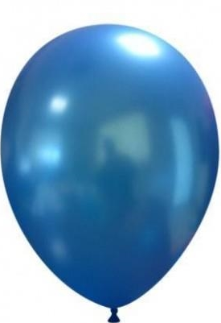





Sensori di
Metalli
Marcatori
Biologici
Sensori di
pH
Sensori di
molecole
biologiche
Molecole responsive

Slide 4
SENSORI DI METALLI

Slide 5
SENSORI DI METALLI

Slide 6


Slide 7
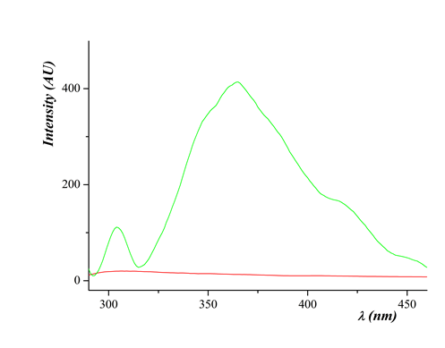
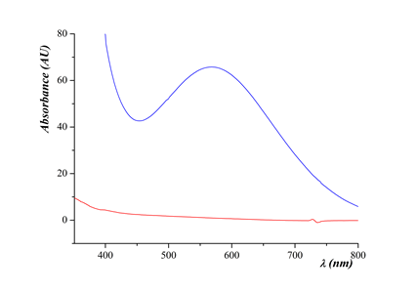
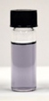
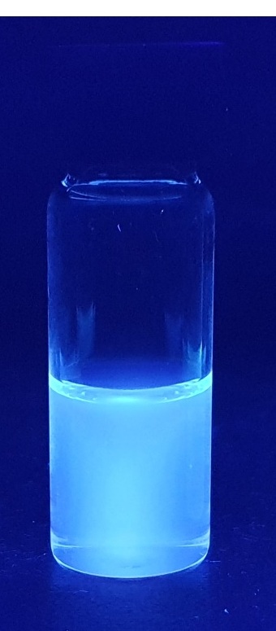
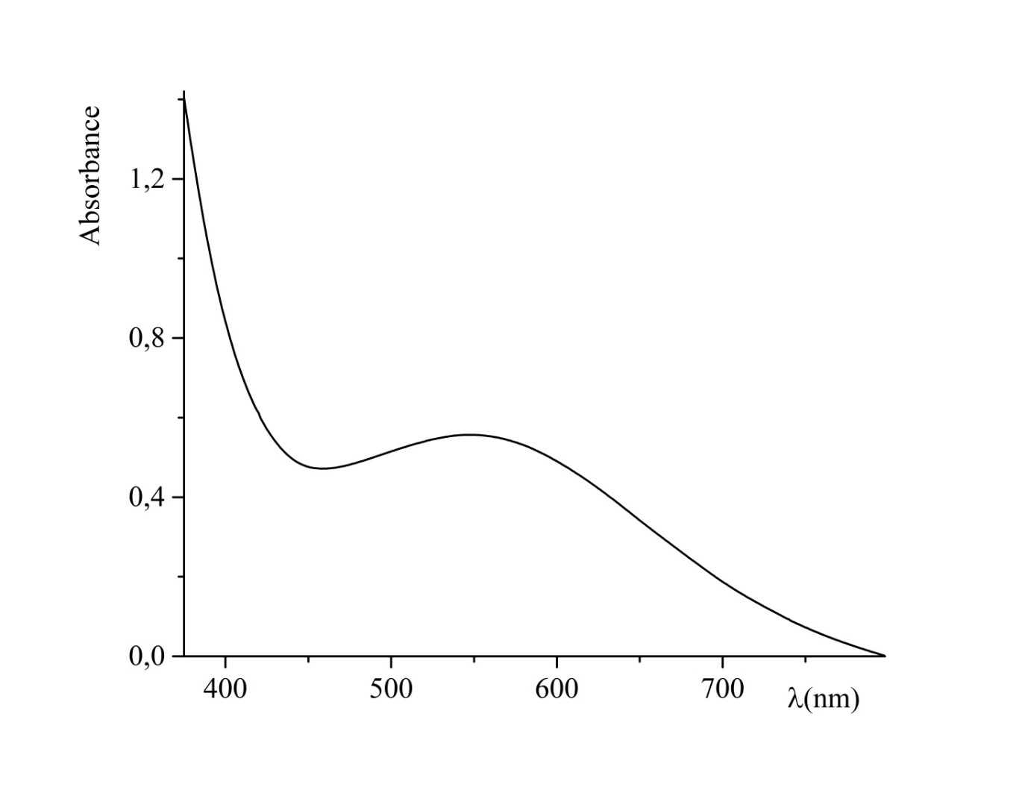
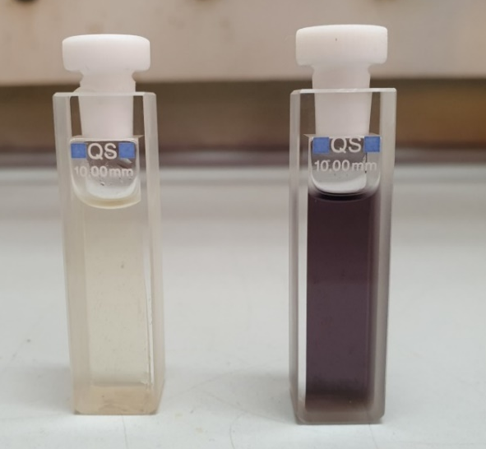
“A Novel Chemo-Sensor for Detection of Iron and Zinc Ions in Drinking Water”
“Synthesis and characterization of a calorimetric chemosensor for the detection of the iron cation in aqueous solutions. An applicative example: the bay leaf infusion”

Slide 8
SENSORI DI pH

Slide 9
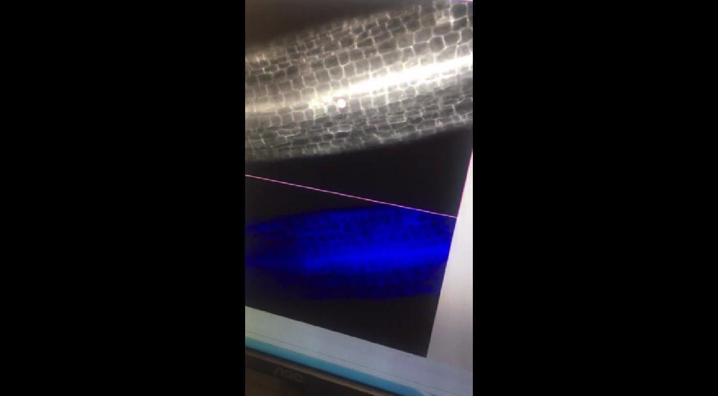
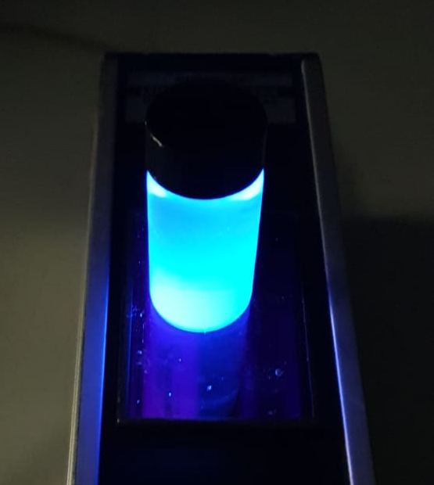
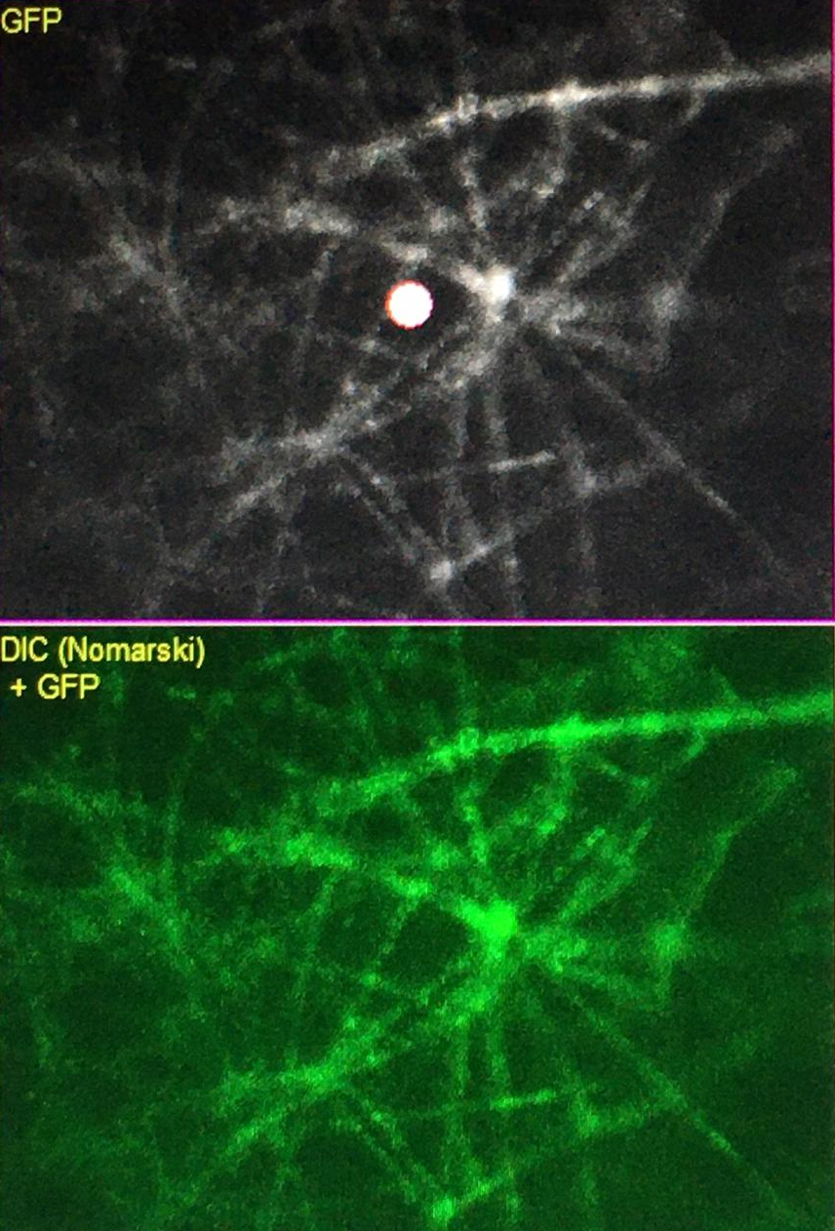
Marcatori fluorescenti solubili in liquidi biologici

Slide 10



Materiali Emissivi: OLED BiomaterialiPackaging
Sensori Polimerici
Smart
Glass
Smart Materials

Slide 11





main-chain
side-chain
guest host /
blend

Slide 12
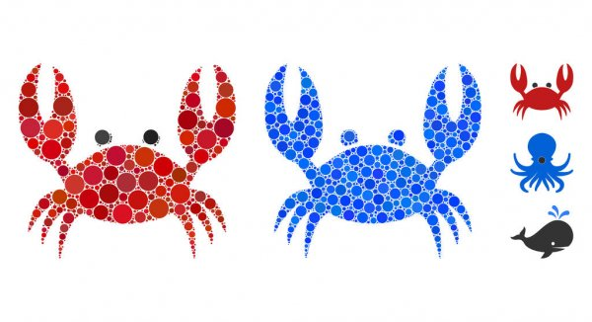



coordination polymers (CPs)

Slide 13



metallopolymer

Slide 15
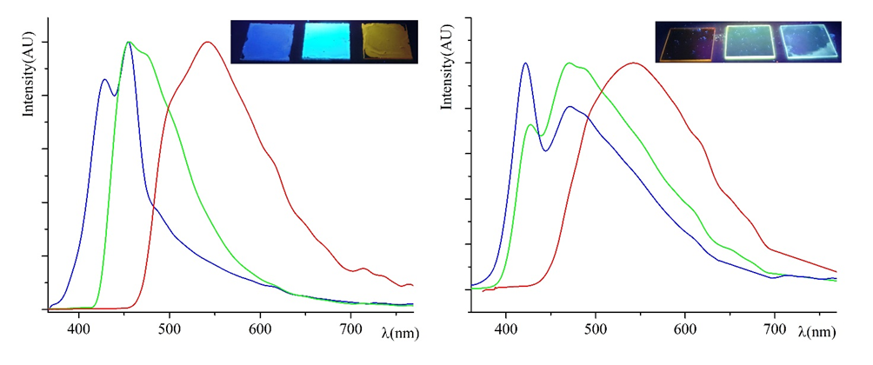
SENSORI DI UMIDITÀ
Figure 1. Normalized emission curves recorded on crystalline thin film samples of M1 (blue curve), M2 (green curve) and M3 (red curve). In the inset the same spin-coated thin films (respectively M1, M2 and M3 from left to right) photographed under the UV lamp at 365 nm.

Slide 16

Materiali Emissivi: OLED

Slide 17
Smart Glass
AAAAA

Slide 18
Grazie per l’attenzione

