Slide 1
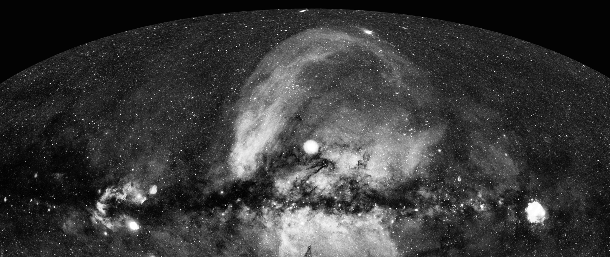









AGN Variability with
eROSITA on SRG
Andrea Merloni (MPE)
On behalf of the eROSITA-DE team

Slide 2
AGN Variability with
eROSITA on SRG
Andrea Merloni (MPE)
On behalf of the eROSITA-DE team

Slide 3
AGN Variability with
eROSITA on SRG
Andrea Merloni (MPE)
On behalf of the eROSITA-DE team

Slide 4


Outline
SRG/eROSITA Mission
  Characteritics, status, operations, milestones
AGN surveys with eROSITA: eFEDS
The all-sky survey and the first data release
  The X-ray catalogs in DR1
  Time Domain studies: AGN, QPEs, TDEs
Highlight talks
  D. Homan: Extreme AGN variability
  A. Markowitz: Cloud occultation events and clumpy Torii
  T. Liu: eROSITA South Ecliptic Pole AGN monitoring
  Z. Liu: A repeating Partial TDE

Slide 5
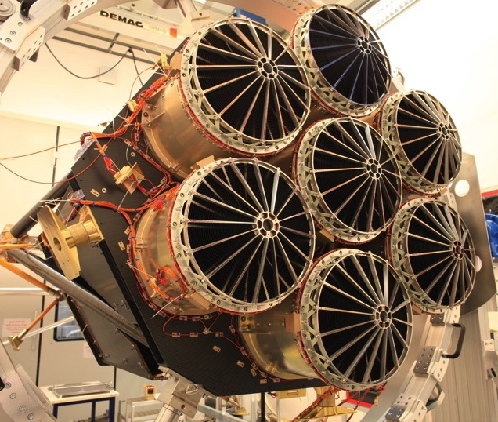
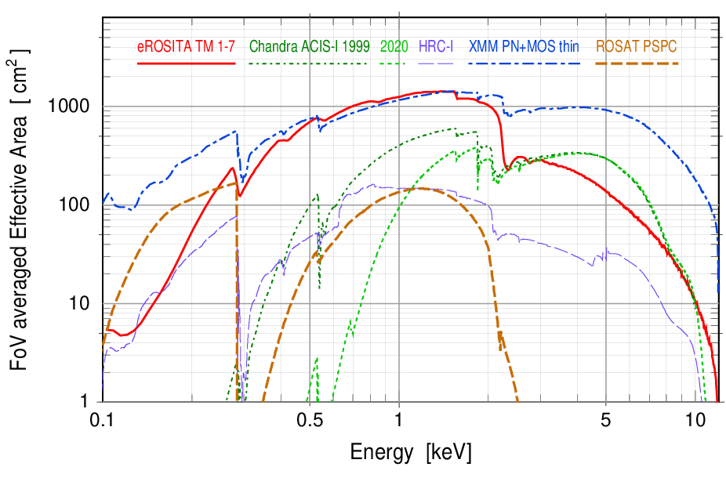
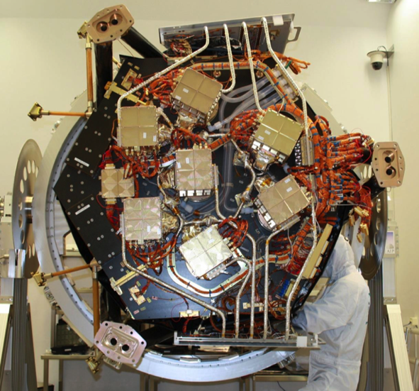
eROSITA on SRG [Predehl et al. 2021]
Large Effective area (~1300 cm² @1keV, ~XMM-Newton)
Large Field of view: 1 degree (diameter)
Half-Energy width (HEW) ~18” (on-axis, point.); ~30” (FoV avg., survey)
  Positional accuracy: ~4.5” (1σ)
X-ray baffle: 92% stray light reduction
pnCCD with framestore: 384x384x7~10⁶ pixels (9.4”), no chip gaps, no ‘out of time’ events,
Spectral resolution at all measured energies within specs (~80eV @1.5keV)

Slide 6
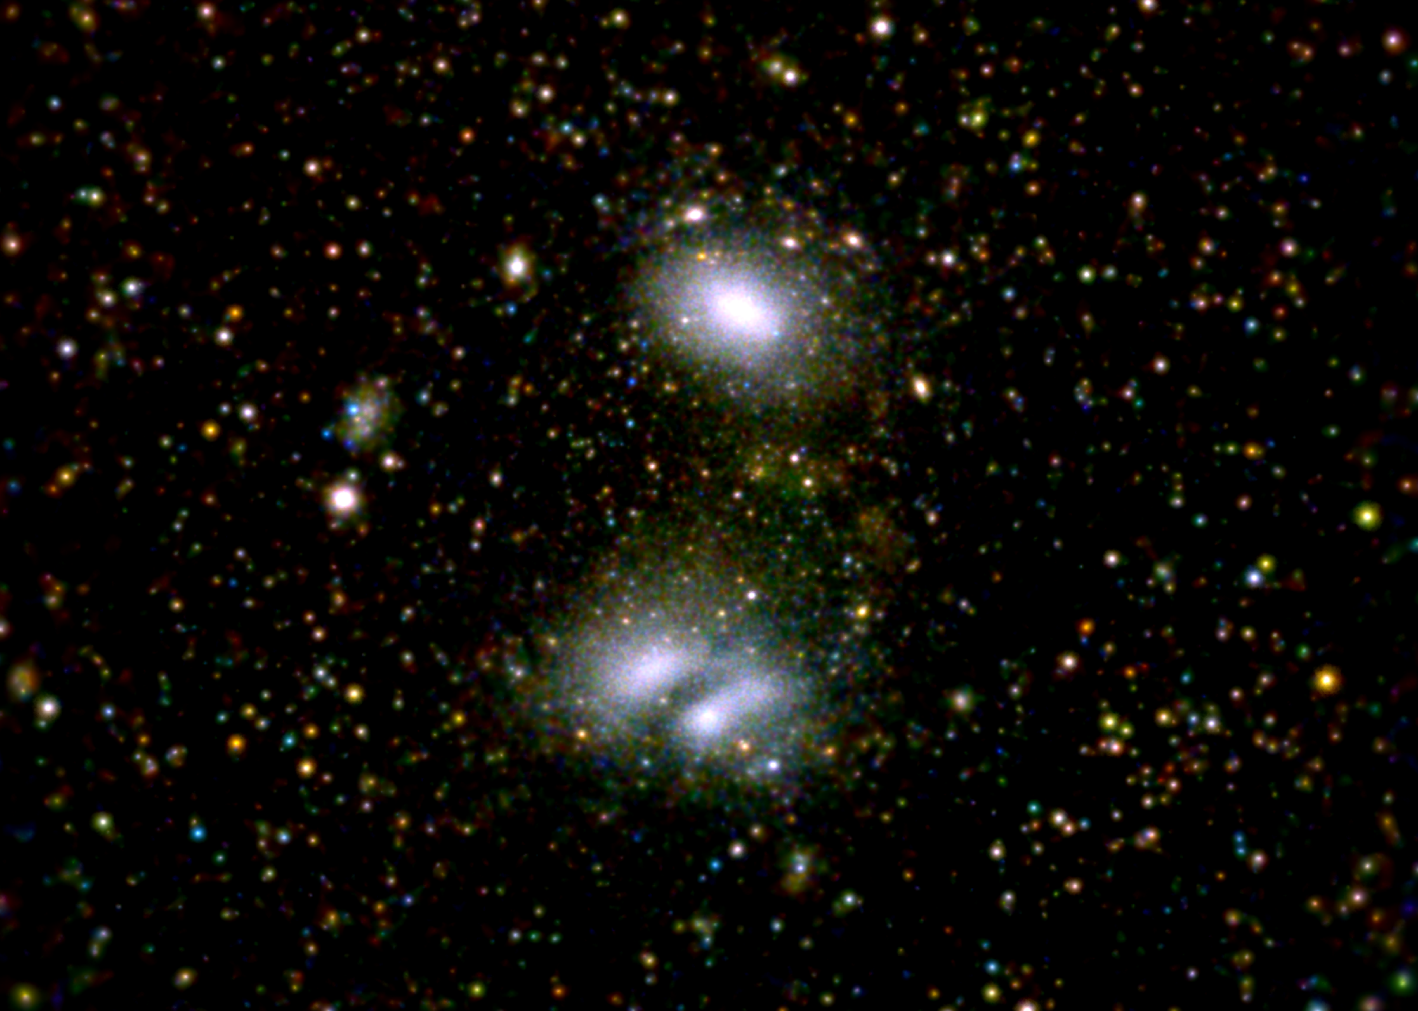
eROSITA’s advantage: large Field of View and Grasp
SRG/eROSITA 0.4-3.0 keV
Abell 3391/3395
30’
Moon diameter
30 arcmin
Grasp (= survey speed)
- 5 x XMM-Newton
- 100 x Chandra (today)
1 degree
eROSITA is a superb tool to image
Large Scale Structures
As Cluster finding machine, it is a Stage IV
Cosmology experiment
eROSITA
Field of view ~ 62 arcmin
XMM-Newton
Field of view ~ 30 arcmin
+
=
Chandra
Field of view ~ 17 arcmin
Scanning feature
3 Observing modes:
continuous scan (survey), field scan, pointing
SRG/eROSITA 0.2-2 keV image of A3391/3395
(Reiprich et al. 2021)
Gaussian adaptive smoothing
0.4-0.8: red
0.8-1.5: green
1.5-3.0: blue

Slide 7
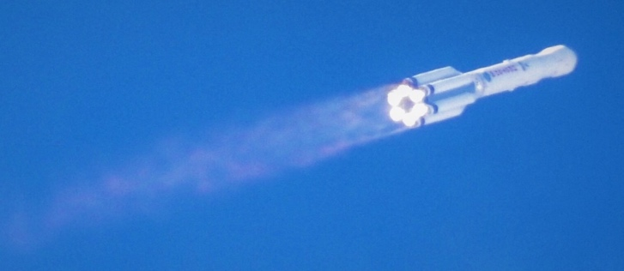
Programmatics
eRASS = eROSITA All-Sky Survey
CalPV:
Calibration and
Performance Verification
26.2.2022
eROSITA in safe mode
eRASS8
All-sky survey
eRASS1
eRASS3
eRASS2
eRASS4
eRASS5
eRASS6
eRASS7
2.5-years pointed observations
GTO/GO phase
2019
2020
2021
2022
2023
2024
2025
2026
Launch
July 1st 2021: EDR
CalPV data
and associated papers
DR1
eRASS1
Q4 2023
DR2
eRASS:3
Q2 2025
TBC
DR3
All-sky survey
Q2 2027
TBC
Early Data Release (EDR) in 2021: several fields, including eFEDS mini-survey
Preparation ongoing for DR1 in Fall 2023

Slide 8


eFEDS: a preview survey
140 deg²; ~2.5ks exposure; ~27k X-ray sources; ~12k spec-z (SDSS-IV,V)
Flux limit (0.2-2.3 keV) ~7e-15 erg/s/cm² [Brunner et al. 2022]
Credit: H. Brunner, M. Ramos-Ceja
Exposure corrected image in the 0.5–2.0 keV band

Slide 9
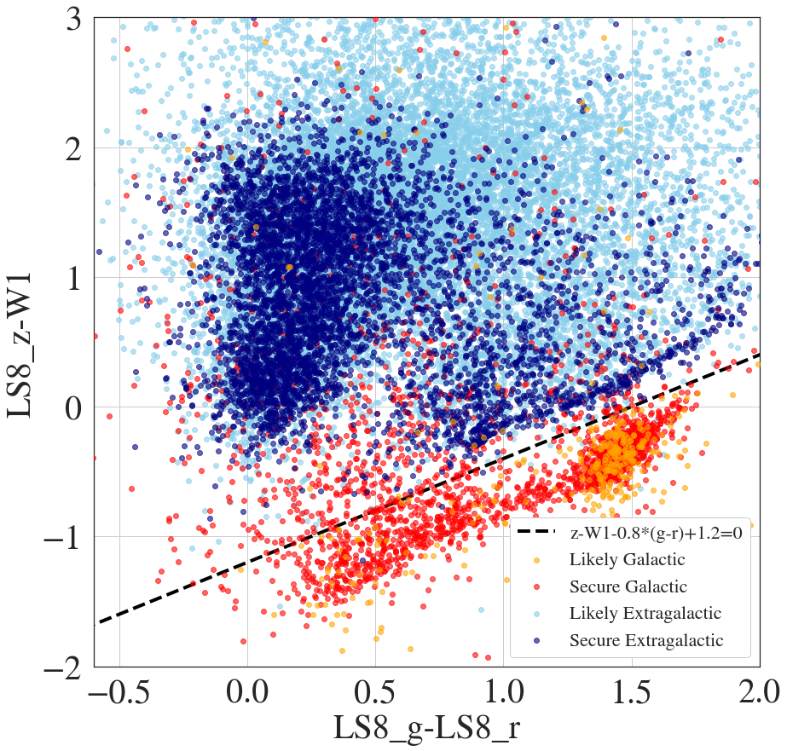
eFEDS: X-ray populations
Red, orange: galactic
Blue, cyan: extragalactic
NIR-MIR color
Optical g-r color
Salvato+22, Liu+22

Slide 10
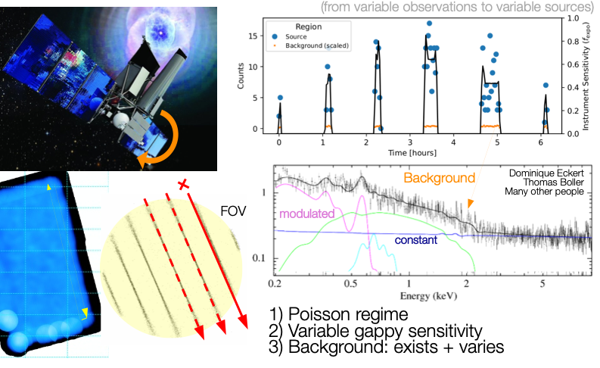
Variability studies: Challenges
Courtesy of J. Buchner (MPE)

Slide 11
eFEDS, proof of concept
Boller et al. (2021); Buchner et al. (2021)

Slide 12
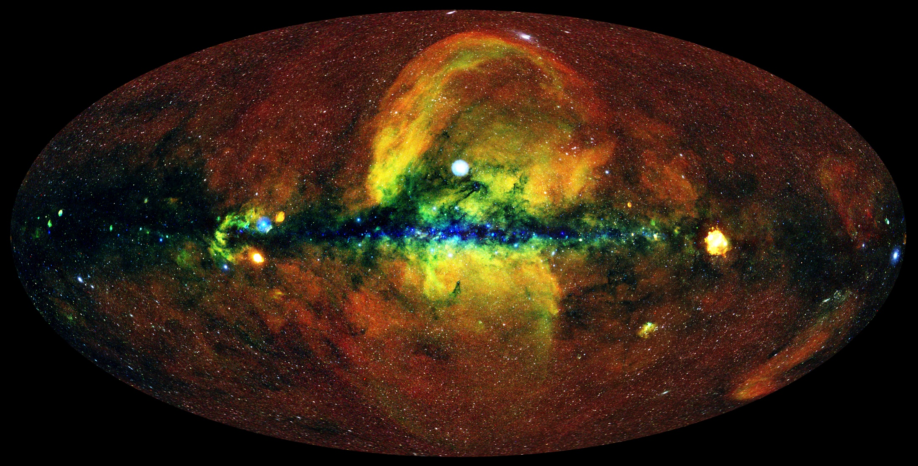
The eRASS1 X-ray sky
R: 0.3-0.6 keV
G: 0.6-1.0 keV
B: 1.0-2.3 keV
~10’ smooth.
IKI
J. Sanders, H. Brunner (MPE), E. Churazov, M. Gilfanov (IKI), and eSASS team
MPE

Slide 13
The All-Sky Surveys by Numbers
Completed 4 all-sky survey (12/2019 – 12/2021)
Uniform exposure, avg.~800s; up to 120ks at the Ecliptic Poles (confusion limited)
Very few background flares, flexible mission planning: no gaps in exposure
~1.6 Billion 0.2-5keV calibrated photons (~350 Gb telemetry)
Typical (point-source) sensitivity:
  Single pass (eRASS1,2,3,4)
    ~5x10⁻¹⁴ erg/s/cm² [0.2-2.3 keV]; 4-5x deeper than RASS
    ~7x10⁻¹³ erg/s/cm² [2.3-5 keV]
  Cumulative (eRASS:4)
    ~2x10⁻¹⁴ erg/s/cm² [0.2-2.3 keV]
    ~2x10⁻¹³ erg/s/cm² [2.3-5 keV]
eRASS1 (half-sky): 0.9M point sources ~doubles the number of known X-ray sources!
eRASS:4 (half-sky): 2.8M point sources; 87k extended; ~45k confirmed clusters

Slide 14
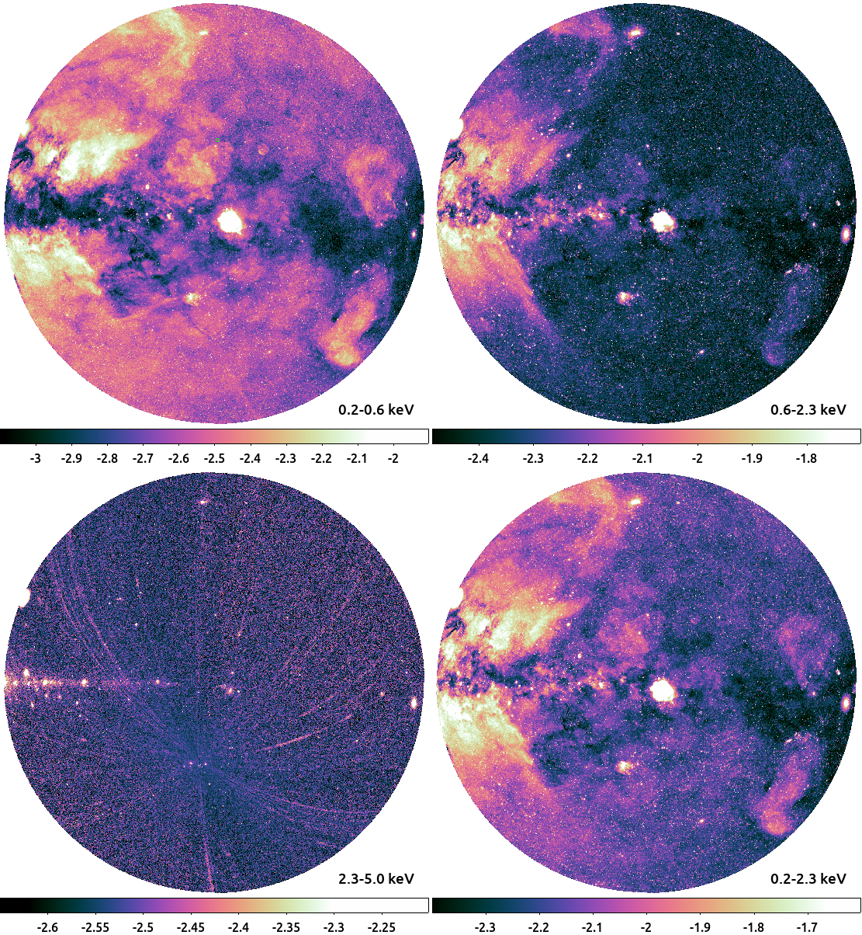
DR1 products
Software
Calibration DB
Attitude files
Exposure maps
Events
Count rate maps
Source catalogues
Light curves
Spectra
Candidate Counterparts
Merloni et al., submitted

Slide 15
eRASS1 Catalogues
Soft band 0.2-2.3 keV, Point sources: 903k
Soft band 0.2-2.3 keV, extended: 26.6k (of which 12k optically confimred clusters)
Hard band 2.3-5 keV, Point Sources: 5k
Hard band 2.3-5 keV, Extended: 380
Merloni et al., submitted

Slide 16
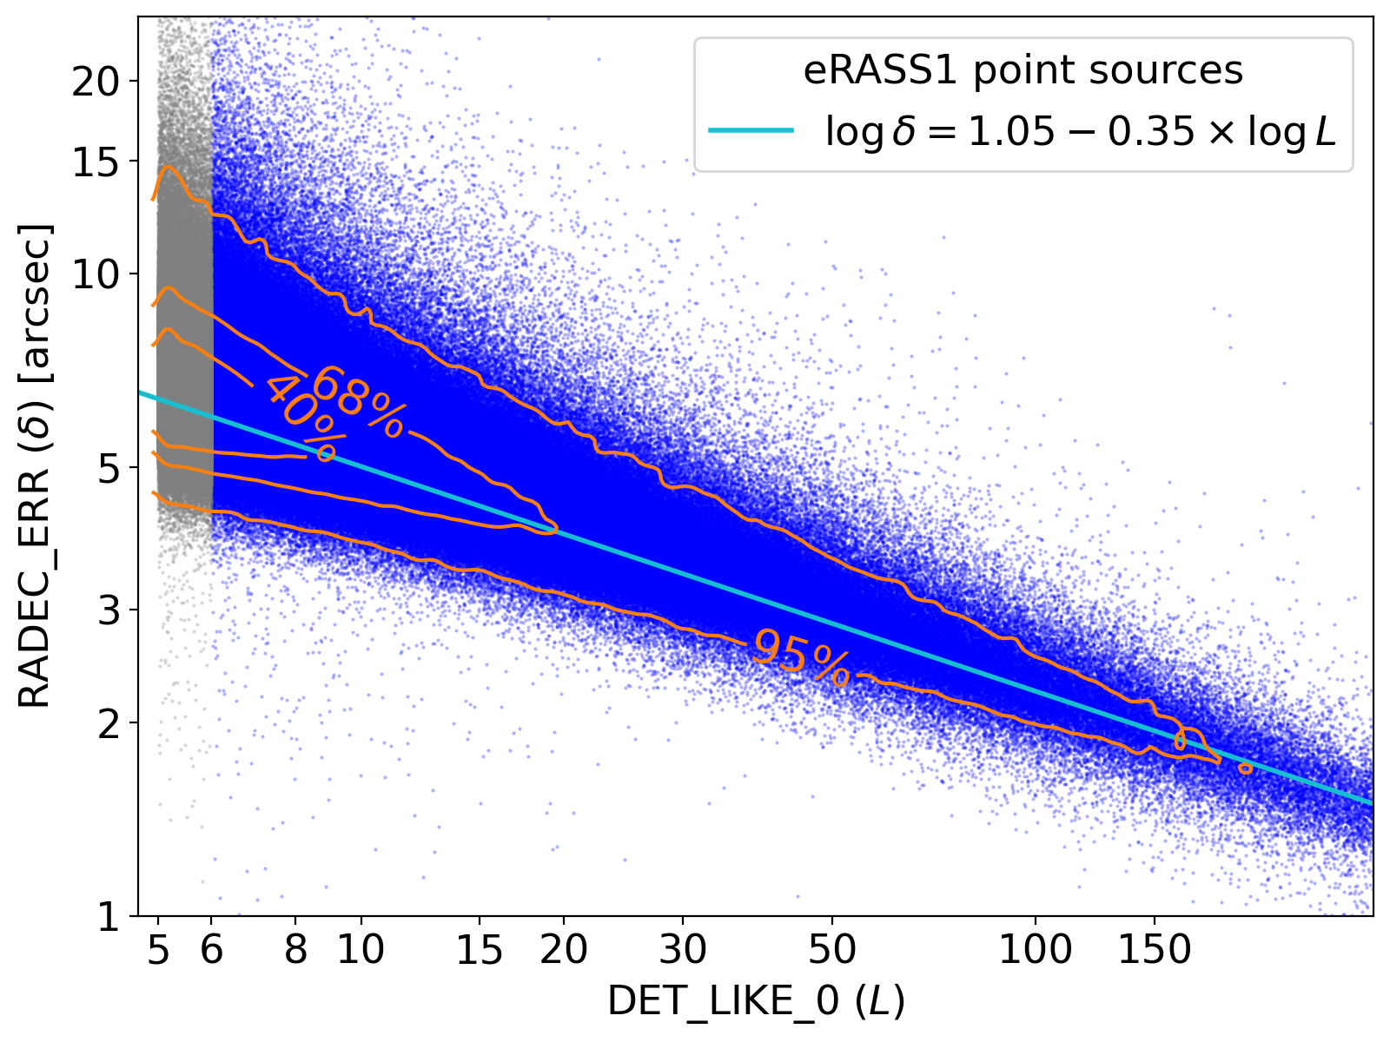
eRASS1 Catalogues
Log of 0.5-2 keV flux limit
Point sources astrometric accuracy
Median positional error = 4.3”
Merloni et al., submitted

Slide 17
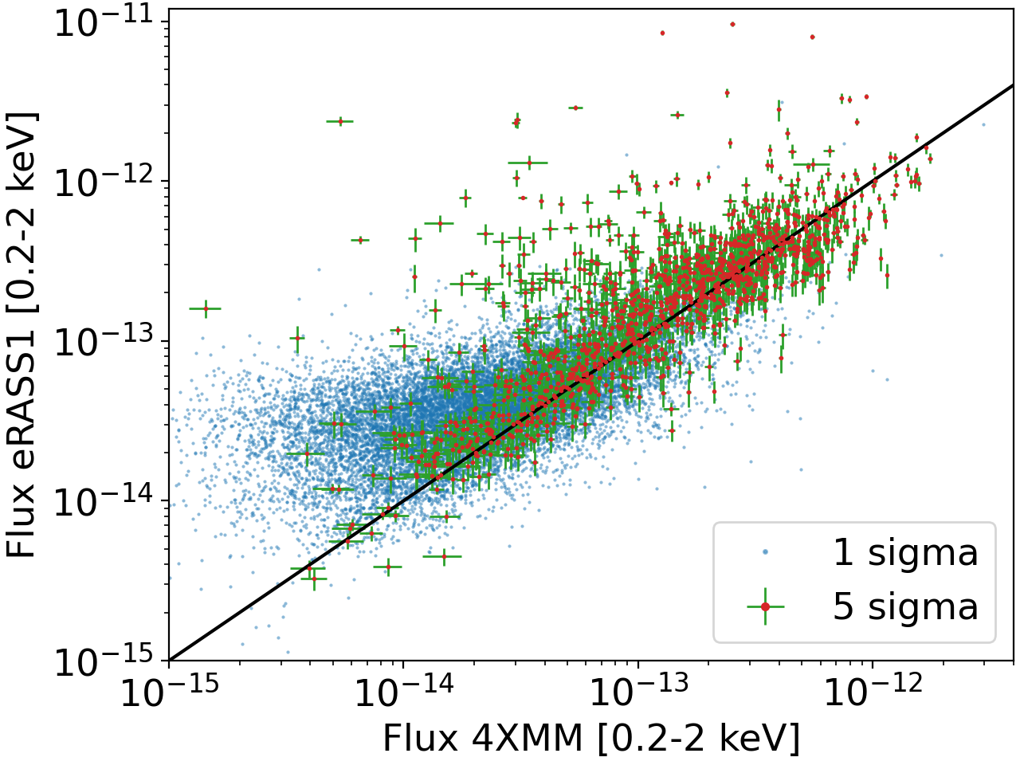
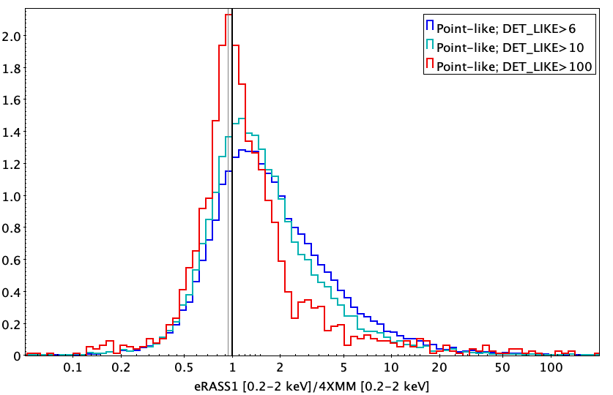
eRASS1: Comparison with 4XMM
Photometric consistency with 4XMM better than ~10% [expected mis-calibration ~6%]

Slide 18
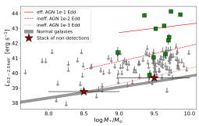
A teaser: X-ray view of variability-selected IMBH candidates
eRASS1/eRASS:4 X-ray coverage of ~200 UVOIR variability selected AGN in Dwarf galaxies
(mostly from PTF: Baldassarre+ 2020; WISE: Ward+ 2020)
z<0.1
z<0.1
Arcodia et al. in prep.

Slide 19

eRASS in time domain
eRASS1 cts rate image
Movie courtesy
of J. Sanders (MPE)

Slide 20
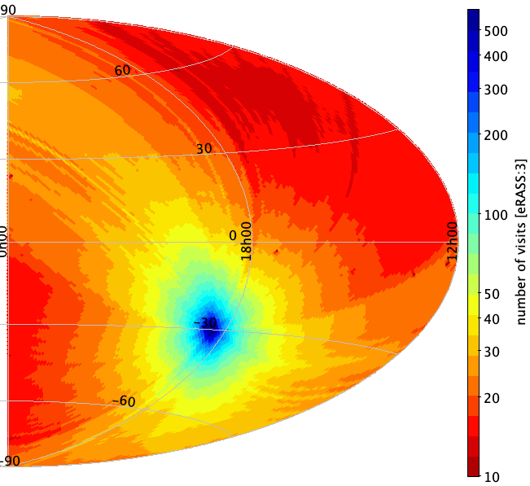
eRASS: Timescales
eRASS:3 “Visits” Map
50 msec [Readout]: Time resolution of each CCD (frame readout cycle)
40 sec [Visit]: Scan speed + 1 deg. FoV (avg effective exposure)
4 hours [eRoday]: Rotation period of SRG (Interval between scans/visits)
1 day [Visibility]: avg. visibility length (~6 visits)
6 months [eRASS]: one complete all-sky survey (revisit period for most of the sky)
4 years: 8 all-sky surveys

Slide 21
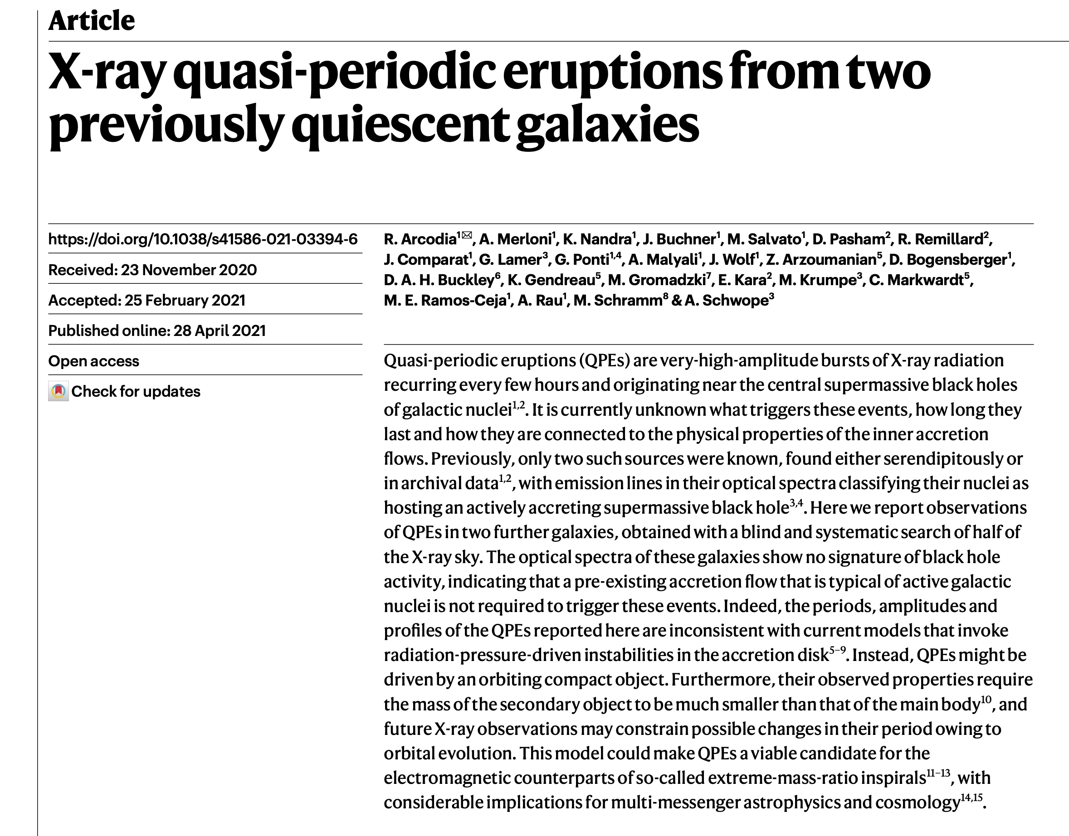
eRASS: Timescales
eRASS:3 “Visits” Map
50 msec [Readout]: Time resolution of each CCD (frame readout cycle)
40 sec [Visit]: Scan speed + 1 deg. FoV (avg effective exposure)
4 hours [eRoday]: Rotation period of SRG (Interval between scans/visits)
1 day [Visibility]: avg. visibility length (~6 visits)
6 months [eRASS]: one complete all-sky survey (revisit period for most of the sky)
4 years: 8 all-sky surveys
Notes:
50 ms (fastest CCD in full frame)

Slide 22
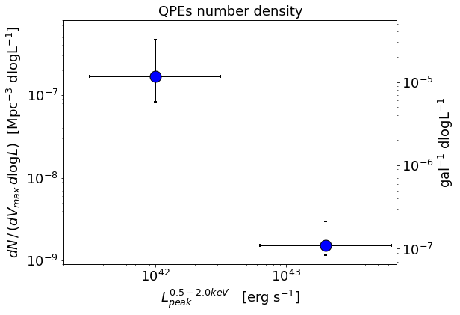
Volumetric rates of QPEs
Using eROSITA: number density of sources emitting QPEs at any time
Preliminary
Arcodia+ in prep.
Courtesy of R. Arcodia
Comparison: <∼1% TDEs rates !

Slide 23
eRASS: Timescales
eRASS:3 “Visits” Map
50 msec [Readout]: Time resolution of each CCD (frame readout cycle)
40 sec [Visit]: Scan speed + 1 deg. FoV (avg effective exposure)
4 hours [eRoday]: Rotation period of SRG (Interval between scans/visits)
1 day [Visibility]: avg. visibility length (~6 visits)
6 months [eRASS]: one complete all-sky survey (revisit period for most of the sky)
4 years: 8 all-sky surveys
See Alex Markowitz and David Homan’s talks
Notes:
50 ms (fastest CCD in full frame)

Slide 24
Searching for TDE in eROSITA (eRASS:5 data)
Grotova et al. in prep.

Slide 25
Grotova et al. in prep.
See also Sazonov et al. 2021

Slide 26
eROSITA TDEs: highlights
eROSITA has expanded the sample of X-ray bright TDEs by more than one order of magnitude already
  70-90% do not show optical transient emission within 3 years prior to and during the X-ray flares -> Optical spectroscopic classification often impossible!
eROSITA has discovered several repeating TDE in quiescent galaxies
  Produced by partial Tidal Disruption events (theoretically predicted to be the majority of TDE in the local Universe)?
  Are some of these related to stars on eccentric orbits around SMBHs?
  Do not miss Z. Liu’s talk tomorrow!
Analysis of follow-up campaigns of brighter event ongoing
  Malyali+ ‘21; Malyali+ ‘23a, ‘23b, ‘23c; Homan+ ’23; Liu+ ‘23

Slide 27
eRASS1 lightcurves and spectra
SMSS J1144; z=0.89
(Onken+ ‘22; Kammoun+ ‘23)
eROQPE1 (Arcodia+ ‘21)
(See M. Giustini’s Review talk)
Brightest SEP AGN
(See Teng Liu’s Talk)

Slide 28
Conclusions
eROSITA on SRG has been in operation since more than 2 years. All subsystem are working with minimal losses. We have completed 4.4 all-sky surveys
eROSITA is in safe/idle mode since 26.2. Science operations are suspended. If/when they will resume is unclear
Thanks to its large Grasp, stable background and observing cadence eROSITA opens up new parameter space for X-ray astronomy across different source classes
Time-domain studies of AGN are a unique by-product of the scanning strategy, providing multi-epoch information on hundreds of thousands of objects
TDE and CLAGN discovery space is very large!
First all-sky survey (eRASS1) data release (DR1) coming in Fall 2023

Slide 29
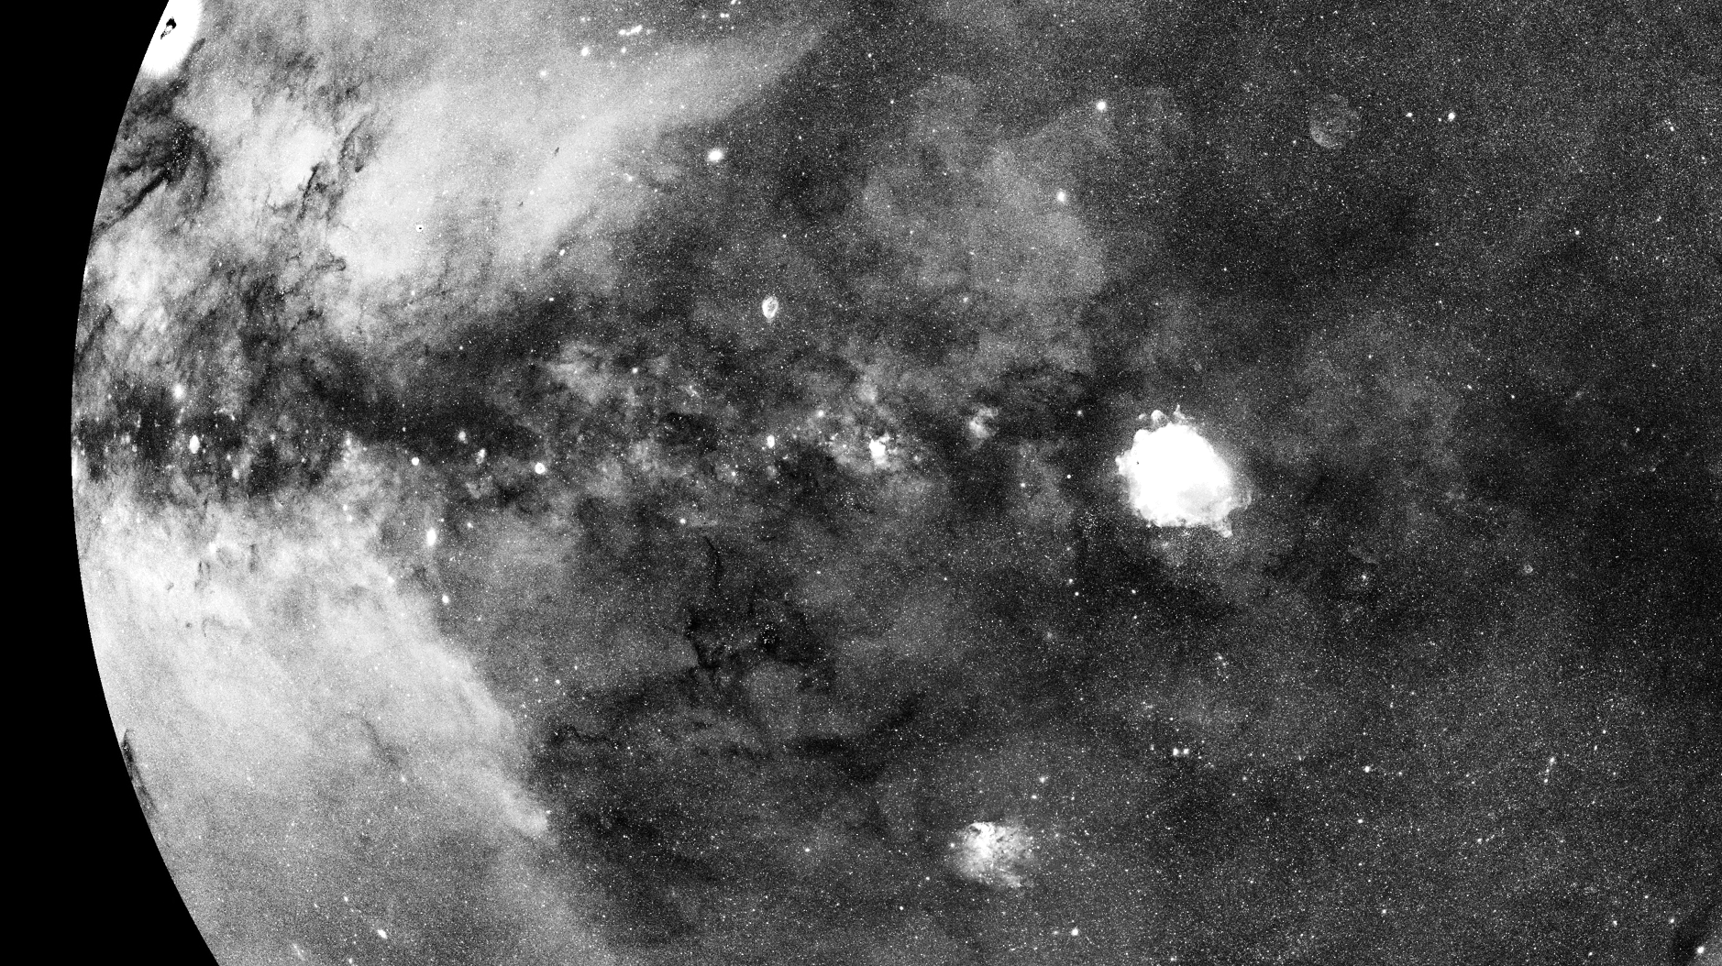
www.mpe.mpg.de/eROSITA
Thank you

