Slide 1
Music Worlds and Event Networks
Nick Crossley
Mitchell Centre for Social Network Analysis
University of Manchester (UK)
<nick.crossley@manchester.ac.uk>

Slide 2
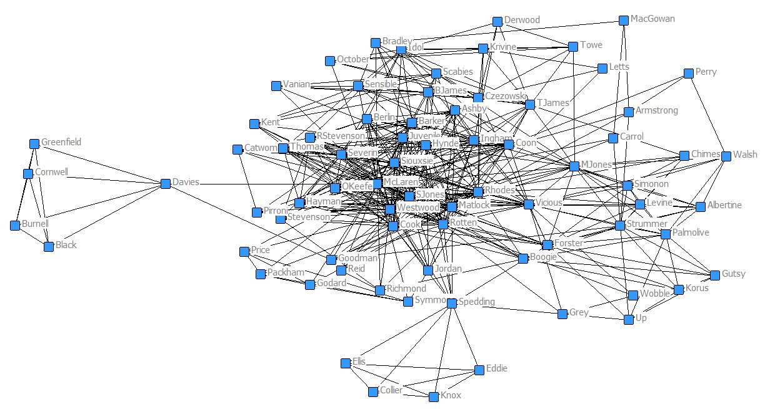
‘Music worlds’ are clusters of musical interaction, centred around a location, musical style, form of organisation and/or a political orientation.
Can have trans-local and/or virtual dimensions. Might be entirely translocal/virtual.
Previously analysed as networks of participants.

Slide 3
Participant networks are important but only offer a partial perspective on music worlds.
They fail to capture the episodic nature of music worlds and the spatio-temporal dispersal of their constitutive events.
Worlds are latent much of the time, only coming to life periodically via collective events (e.g. gigs, festivals, rehearsals).
Participants don’t play their musical roles all of the time. They ‘switch’ into them for such events.
Henceforth the events we are interested in are gigs and festivals.

Slide 4
Gigs are bounded in time and space. They have beginnings, endings and barriers excluding outsiders.
But within worlds they are linked by a flow of subsets of the same participants (artists, audiences and ‘support personnel’.
This facilitates:
A flow of resources.
The formation/reproduction of (i) a local culture, (ii) a collective identity, (iii) interpersonal connections and local social structure (i.e. ‘participant networks’).
Gigs are shaped by what/who flows into them, and shape subsequent gigs by what/who flows out of them.
The ‘event network’ makes a difference to the events.

Slide 5
Two-mode studies sometimes capture events.
But often only as a means of deriving participant networks.
And they typically ignore both sequential structure and spatio-temporal dispersion.
Time adds structure to a network: e.g.
Ties are asymmetrically directed.
Earlier events have a decreased likelihood of amassing in-degree.
Later events have a decreased likelihood of amassing out-degree.

Slide 6
A two-mode network of underground heavy metal gigs:
474 audience members,
201 artists/bands
148 underground metal events.
Spread across 3 months and 6 English cities.

Slide 7
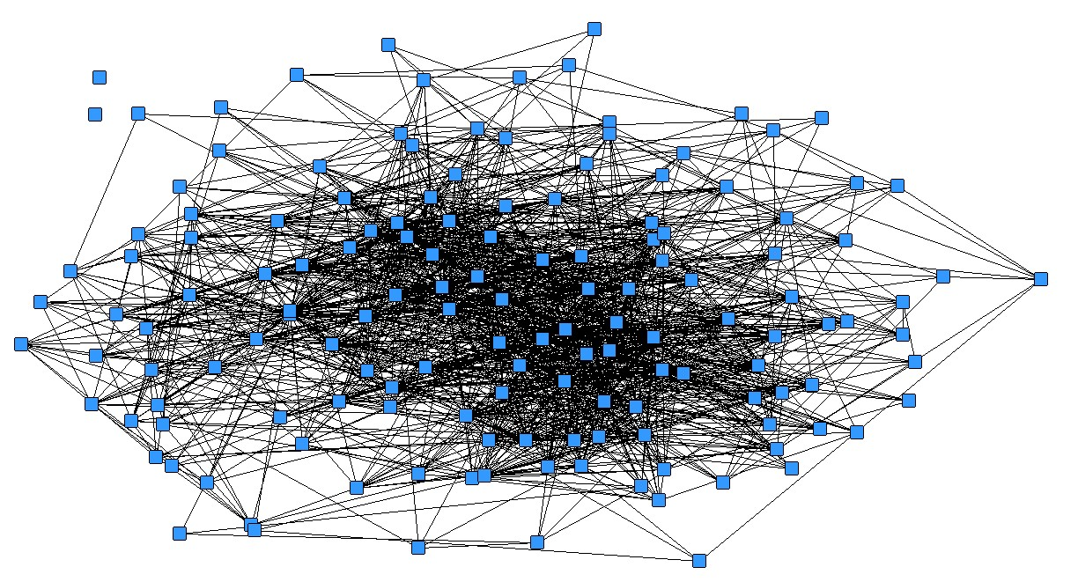
A single-mode projection brings certain structural properties to light: e.g. two isolates + one component; possible core-periphery.
But time and space are absent.
And not only from the graph – from our concept of the network

Slide 8
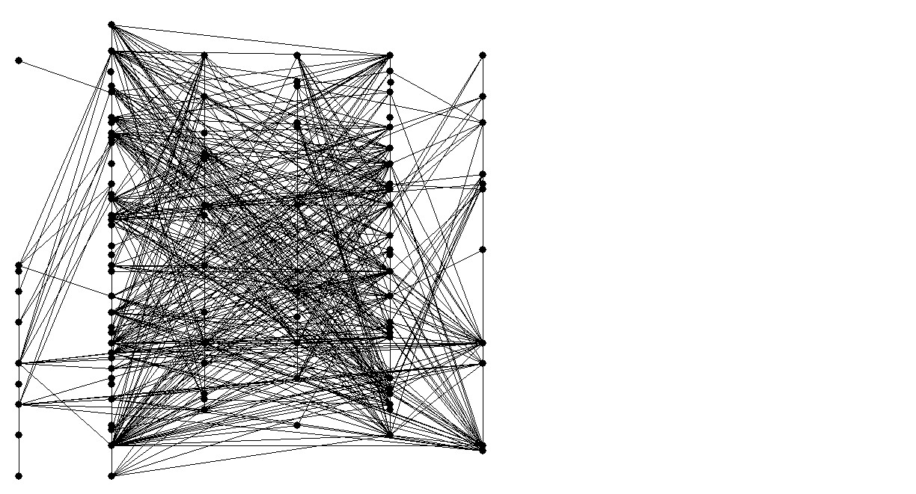
We need also to think about the network like this:
TIME
Bristol London Birmingham Liverpool Manchester Leeds

Slide 9
What about of Lerner and Lomi’s (2022) relational hyperevent models?
This is a definite possibility for the future.
Lerner and Lomi’s intuitions are quite similar to my own.
And it is difficult to factor time in by other means.
But,
As with all models (i) a huge amount of potentially relevant and interesting detail is bracketed out, (ii) there is a danger that we investigate what the model allows us to investigate rather than what might be (more) substantively relevant and important.
RHEMs are still at an early stage of development and therefore quite limited.
For the present I prefer more basic and descriptive methods.

Slide 10
Some Preliminary Analyses of the underground metal networks

Slide 11
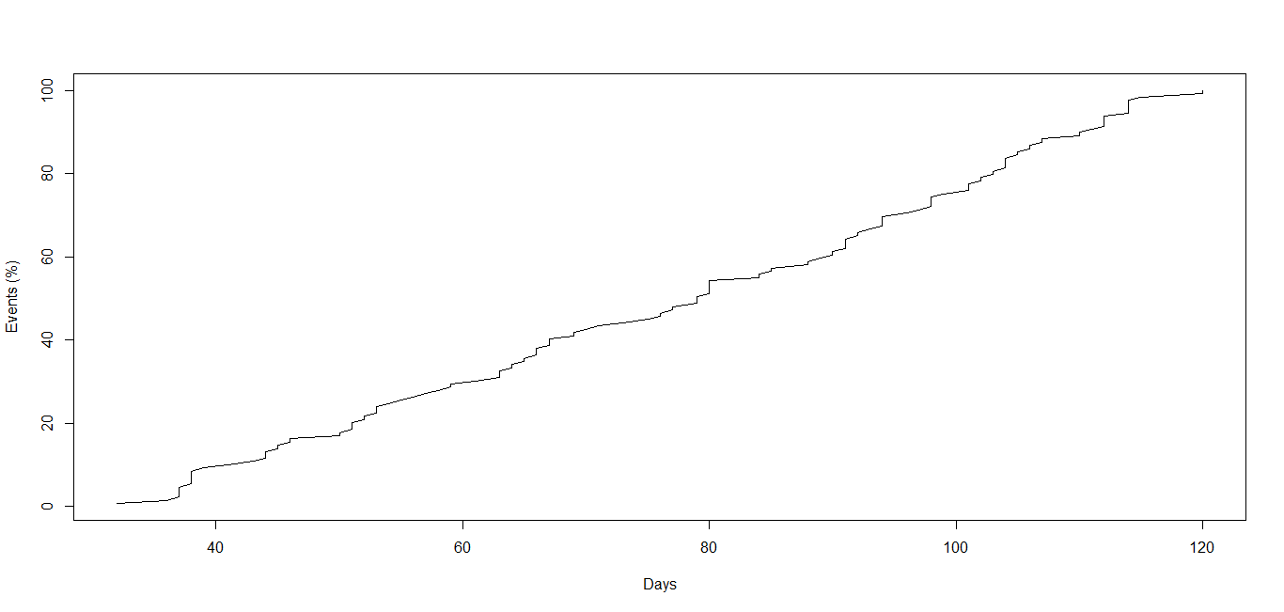
Distribution of Events Across Time (Days by Cumulative Frequency)
Events are evenly distributed but with ‘episodic steps’ (weekends).
Reflecting audience availability?

Slide 12
Do particular combinations of participants recur?
 |  | Participant Type
 |  | Bands | Promoters | Venues
Number of Gigs | Min | 2 | 2 | 2
 | Max | 15 | 88 | 72
 | Mean | 3.9 | 16.4 | 14.6
Bands Worked With (2-3 per gig) | Min | 1 | 1 | 6
 | Max | 55 | 97 | 106
 | Mean | 10.1 | 26.6 | 28.3
Promoters Worked With (generally one per gig) | Min | 0 | 0 | 1
 | Max | 10 | 5 | 9
 | Mean | 2.3 | 1.6 | 3
Venues Used (one per gig) | Min | 1 | 1 | n/a
 | Max | 10 | 11 | n/a
 | Mean | 2.5 | 3 | n/a

Slide 13
Distribution of Events By Place
Why do London and Manchester dominate?
Unequal opportunity to participate.

Slide 14
Local and Translocal Participant Flows Density Matrix and E-I
 | Birmingham | Bristol | Leeds | Liverpool | London | Manchester
Birmingham | .38 | .03 | .05 | .05 | .09 | .09
Bristol |  | .16 | .05 | .04 | .04 | .04
Leeds |  |  | .49 | .08 | .05 | .14
Liverpool |  |  |  | .16 | .07 | .15
London |  |  |  |  | .42 | .14
Manchester |  |  |  |  |  | .43
Expected E-I = .576
Observed E-I = -.107**
There is geographical homophily in the network, pointing to the existence of local worlds.
But local worlds are linked, so we have translocality too.
Actually, audience flows tend to be geographically homophilous, whilst artist flows are heterophilous.
Expected E-I = .58, Audience Observed -.21**, Artist Observed +.88**

Slide 15
However, audiences do travel.
And when they do they often follow particular bands.
We can show this with a QAP logistic regression model.
(dependent variable = audience flow)
 | Model 1 | Model 2 | Model 3
Intercept | .08 | .155 | .067
Geographical Homophily (Odds Ratio) | 8.73** |  | 9.703**
Artist Flow (Odds Ratio) |  | 4.04** | 8.267**
R² | .15** | .01** | .165**

Slide 16
Artist and audience flows differ more generally, making a different contribution to the event network.
 | Audience Flow | Artist Flow | Combined Flow
Components (excluding isolates) | 1 | 24 | 1
Size of Main Component (nodes) | 146 | 42 | 146
Isolates | 2 | 26 | 2
Fragmentation | 0.03 | 0.91 | 0.03
Density | 0.14 | 0.02 | 0.15
Compactness | 0.5 | 0.05 | 0.53

Slide 17
Mean Scores for Festivals and Standard Gigs (with t tests)
Different types of event make a difference too.
 | All | Festivals | Standard Gigs | Difference
Attendees⁺ | 7.2 | 42.6 | 5.99 | 36.6**
Degree | 21 | 64 | 19 | 45**
Indegree# | 9.95 | 40 | 8.7 | 31.3**
Outdegree# | 9.95 | 17.6 | 9.6 | 8
Translocal Degree | 8.14 | 31 | 7.36 | 23.64**
Localities | 3.3 | 5.2 | 3.3 | 1.9*
+ These are numbers of survey respondents in attendance, not all attendees.
# Based upon a reduced network for which dates were available.
*p<.05
**p<.000
‘Translocal degree’ = ties to non-local events.
Localities = number of ‘other’ localities tied to
But festivals occur
late in the sequence

Slide 18
Too much to say, too little time.
But thanks for bearing with me!

