Slide 1
The RELATIONAL FACTOR as a model for INNOVATION and TERRITORIAL DEVELOPMENT.
The case of FONDAZIONE SACCONE in the Campania Region
Vassalluzzo Martina - Trezza Giovanni
Notes:
I will introudus my research named The relational factor as a model for innovation and territorial development. The case of Fondazione Saccone in the Campania Region

Slide 2
OUTLINE
Business Network
Organizational theories
Organizational approaches
THEORETICAL BACKGROUND
MOTIVATING CASE STUDY
DATA COLLECTION
MAIN FINDINGS
Reconstruction the inter-organizational network of Fondazione Saccone
Fondazione Website
Data from administrative archives;
Social Network
Conclusion
Equa distribuzione dei benefici

Slide 3
BUSINESS NETWORK MODEL
STRATEGY
Orientation to innovation and sustainability
SHARED VALUE
Innovation of products and processes
Alignment of the steakholders on a shared path
INNOVATION
PERFORMANCE
SOCIAL CAPITAL
Created by the cohesion of ties and trust
Ciasullo, M. V. (2020). Reti di impresa: Criticità e prospettive per la competitività dei sistemi produttivi campani. FrancoAngeli, Milano
Notes:
To start i want to set a theoretical basis to illustrate the results obteind from this research. «Networking gives to companies more competitive advateg: the network enables faster circulation of information and knowledge. There are four essential areas for the joint creation of value:
Strategy
Performance
Social capital
Innovation
These areas create Shared Value between organisation and steakholders

Slide 4
BUSINESS NETWORKING
Trust (Contractual, Competence and Goodwill)
Information sharing
Joint governance
Flexibility
Innovation
Risk (Performance and Relational)
Same benefits
Equa distribuzione dei benefici
Daniela Mancini, 2011. "L’ azienda-rete e le decisioni di partnership : il ruolo del sistema informativo relazionale," MANAGEMENT CONTROL, FrancoAngeli Editore, vol. 2011(1)
Notes:
We are talking about Business Networking
The alliances are characterized by:
1.Trust, A network needs trust, transparency and clarity between the partners. There are Contractual Trust that is an agreement between the stakeholders; Competence Trust that is the Trust in the skills of the partners and there is the Goodwill Trust: each partners brings improvements
2.Information Sharing and Predisposition of joint governance, each partner wants to cooperate with others
3.Flexibility, the organizations must be inclined to change and
4.Desire to change
5.Fair Benefits each partner must benefit from the same kind of collaboration
But Working in a network can lead to risks like:
1.performance risk failure of cooperation because of wrong investments of money and resources
2.relational risk failure of cooperation because of opportunistic behaviour.
These risks can be avoided by the presence of a social structure.

Slide 5
ORGANIZATIONAL THEORIES
Resource-based view
Institutional theory
Moretti, A. (2018). L’innovazione delle imprese automotive italiane. Pichierri, A., & Pacetti, V. (2021). Le reti organizzative: Che cosa sono e come si studiano. Gius. Laterza & Figli Spa.
Notes:
Two organizational theories:
Resource based view networking learning tool, and exchange of information and knowledge creation
Institutional Theory role of inter-organizational relations are relevant to confirm the company status

Slide 6
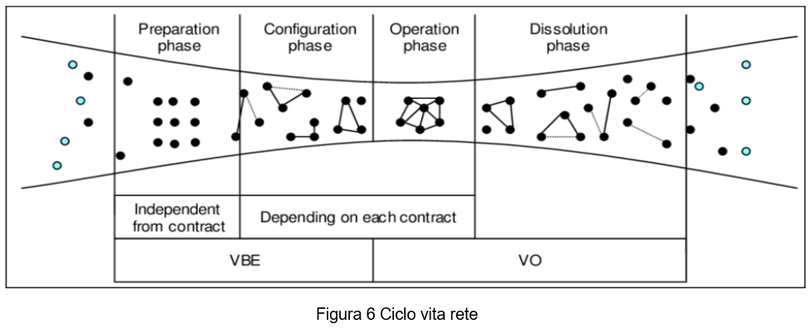
NETWORK LIFE CYCLE
Provan, K.G., Kenis, P. (2008). Modes of network governance: Structure, management, and effectiveness. Journal of public administration research and theory, 18(2), 229-252
Notes:
How do these networks emerge, grow and dissolve over time?
There is a Network Life cycle, we have four steps:
Preparetion Phase which parttners are setting
Configuration phase establishment of true network, defining legal issues and negotiation
Operation Phase daily managment of network
Dissolution phase breakdown of the network at the time when goal of collaboration was archieved

Slide 7
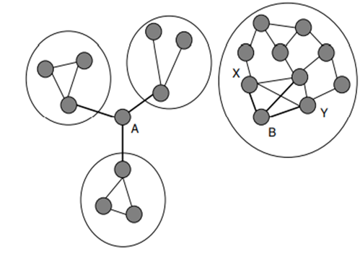
ORGANIZATIONAL APPROACHES
Governance Approach
«Participant-Governed Networks»
«Lead Organization–Governed Networks»
«Network Administrative Organization» (NAO)
Analytical Approach
Strength of Weak Ties Granovetter, 1973
Structural Holes
Burt, 1992
.
Structural Holes
Borgatti, S. P., Halgin, D. S. (2011). On network theory. Organization science, 22(5)
Podolny, J. M., & Page, K. L. (1998). Network forms of organization. Annual review of sociology.
Notes:
In organizational research, two approaches are more widely applied: Governance approach and Analytical Approach

Slide 8
MOTIVATING CASE STUDY
AIM: to reconstruct the inter-organizational network of Fondazione by considering collaborations with other local and national entities
Which is the Network configuration of Fondazione?
Notes:
We are arrived to the focus of this research: the Reconstruction of the inter-organizational network defined by the collaborations between the Foundation and the local authorities of Campania

Slide 9
DATA COLLECTION
Fondazione Saccone Website ;
Consultation of data from administrative archives;
Social Facebook and LinkedIn.
SECONDARY DATA COLLECTION

Slide 10
Partner and collaboration
CTS Members
Knowledge
Spread
Entities
Research
81
Companies
37
Schools and Universities
Advice and
Development
Associations and Sector III
Training
Others
Notes:
The entities present in the networks that will be illustrated shortly, have been divided into categories and each category has been assigned a color.
In the first graphic we can see that Fondazione Saccone has activated more ties with companies. In the second graph, however, the collaborations promoted by the foundation were divided by type and we note that the dissemination of knowledge events like workshops, seminars, conferences, are the most organized activities as well as training events.

Slide 11
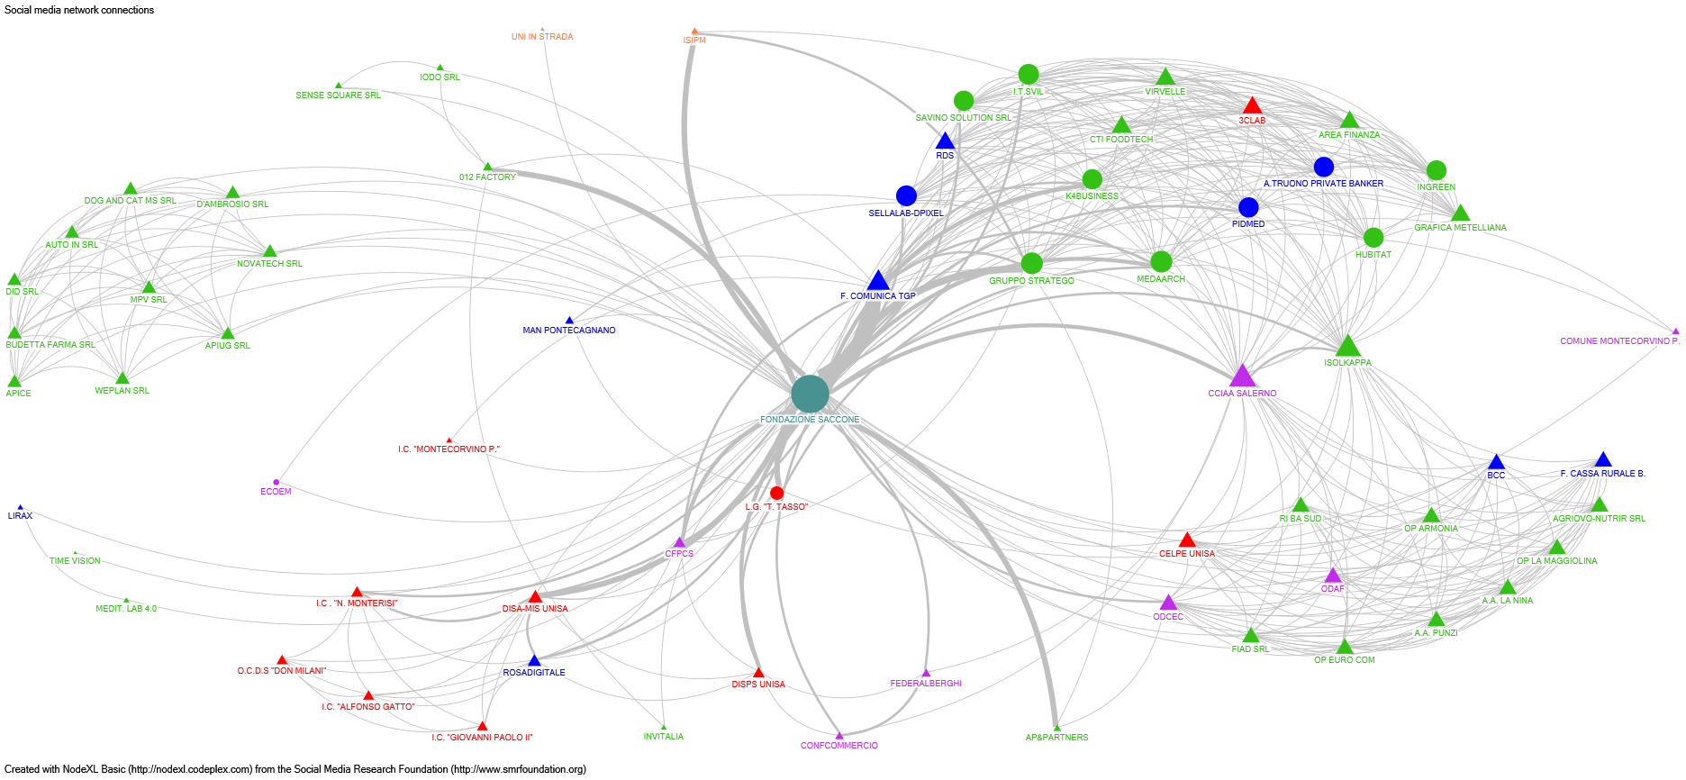
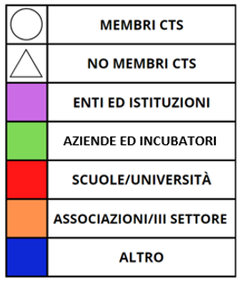
COLLABORATION NETWORK BETWEEN FONDAZIONE SACCONE AND PARTNERS (2019-2022)
Notes:
Here is illustrated the entire network of collaborations built by the FS from 2019 to today. In the GREEN box, for example, we note the collaborations that were born from the consultancy and development project 012Salerno. In the two RED boxes we can extract the two training events like: Formazione 4.0 e Next gen summer school. In the BLUE circles, we find the two searches: : CONSUMTORI POST COVID e FOCUS SOCIO-econ. Sulla città di Battipaglia.
If you pay attention, some links, ie these lines are thicker, than others, this means that those organizations, have more cooperated with the FS

Slide 12
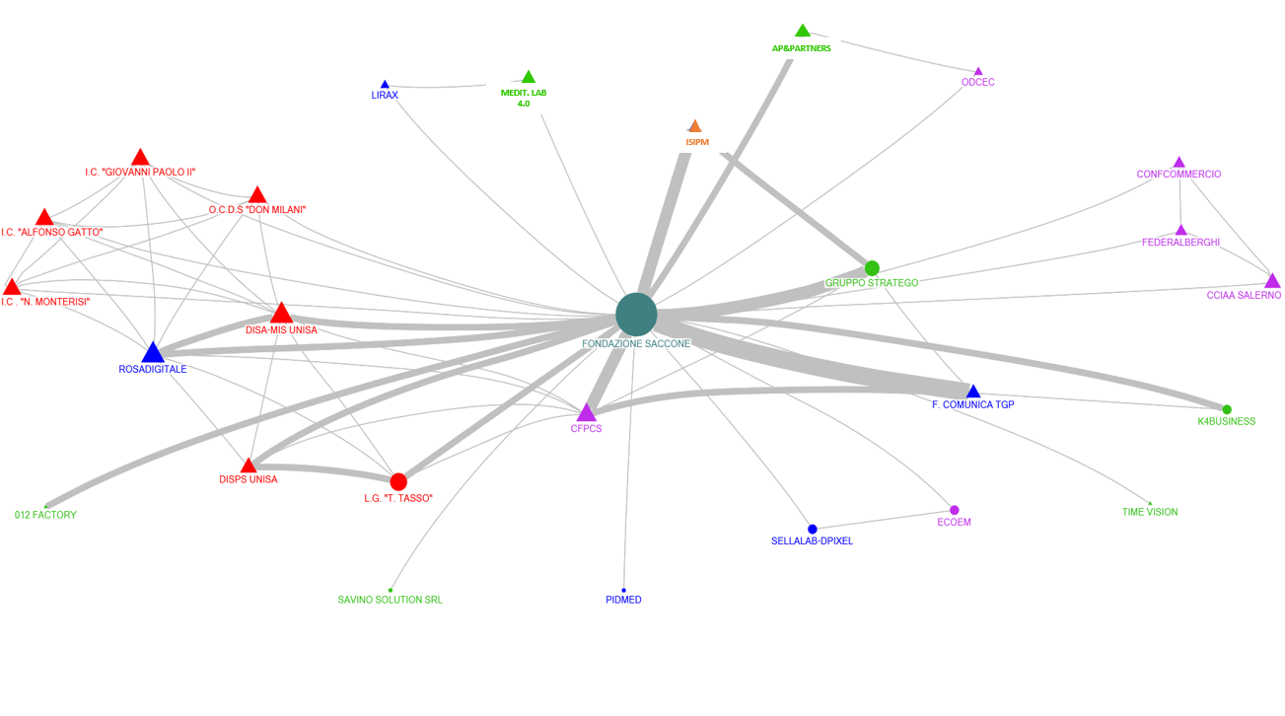
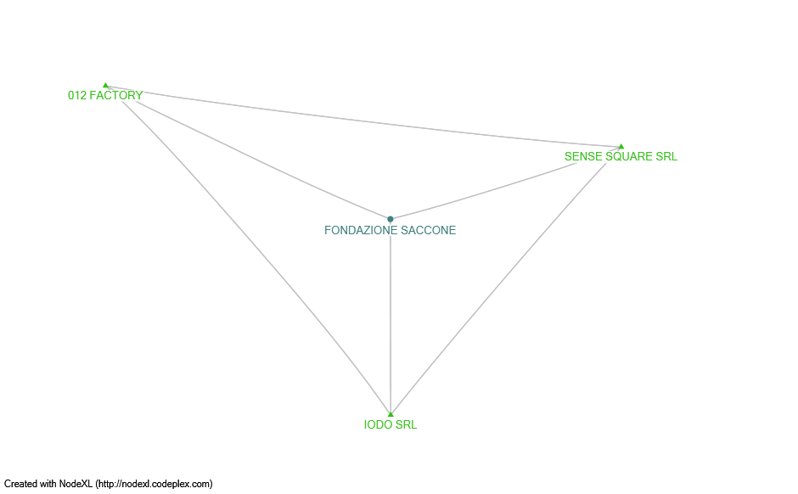
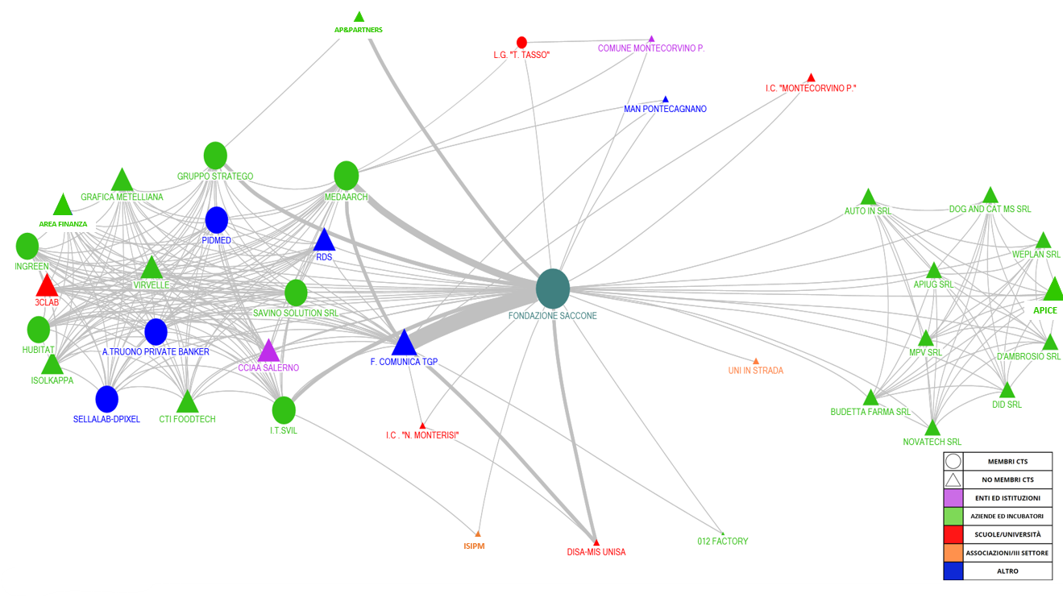
NETWORKS BY COLLABORATION TYPES
KNOWLEDGE SPREAD
RESEARCH
ADVICE AND DEVELOPMENT
TRAINING
Notes:
Here we always have the same network, but illustrated without the FS. It has been useful to understand how the network is transformed and how some entities manage to take more central positions than others thanks to their participation in more events.

Slide 13
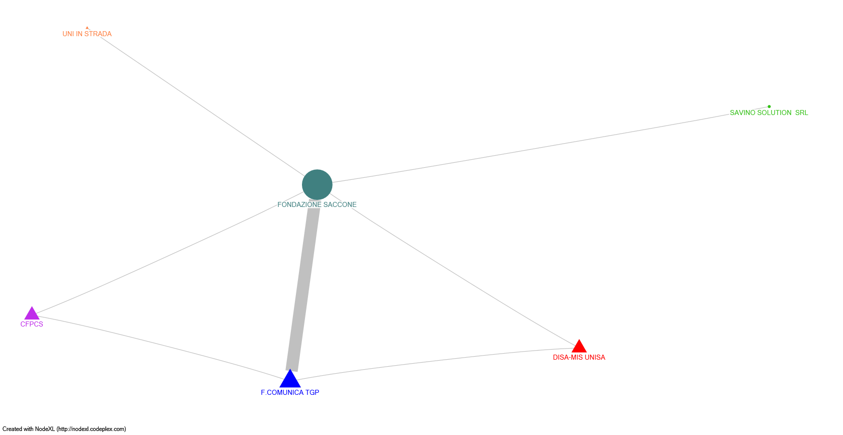
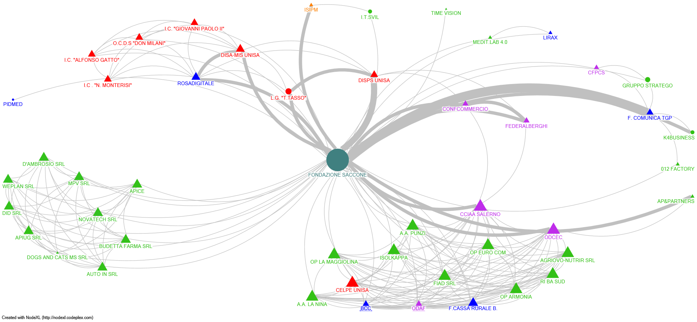
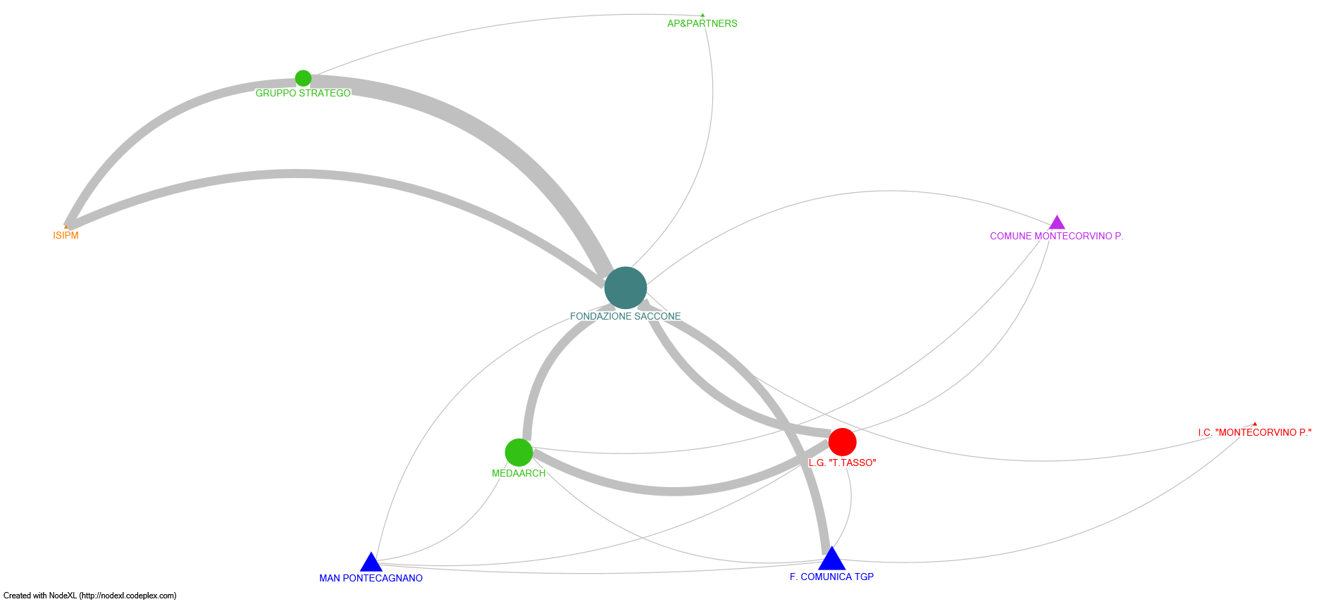
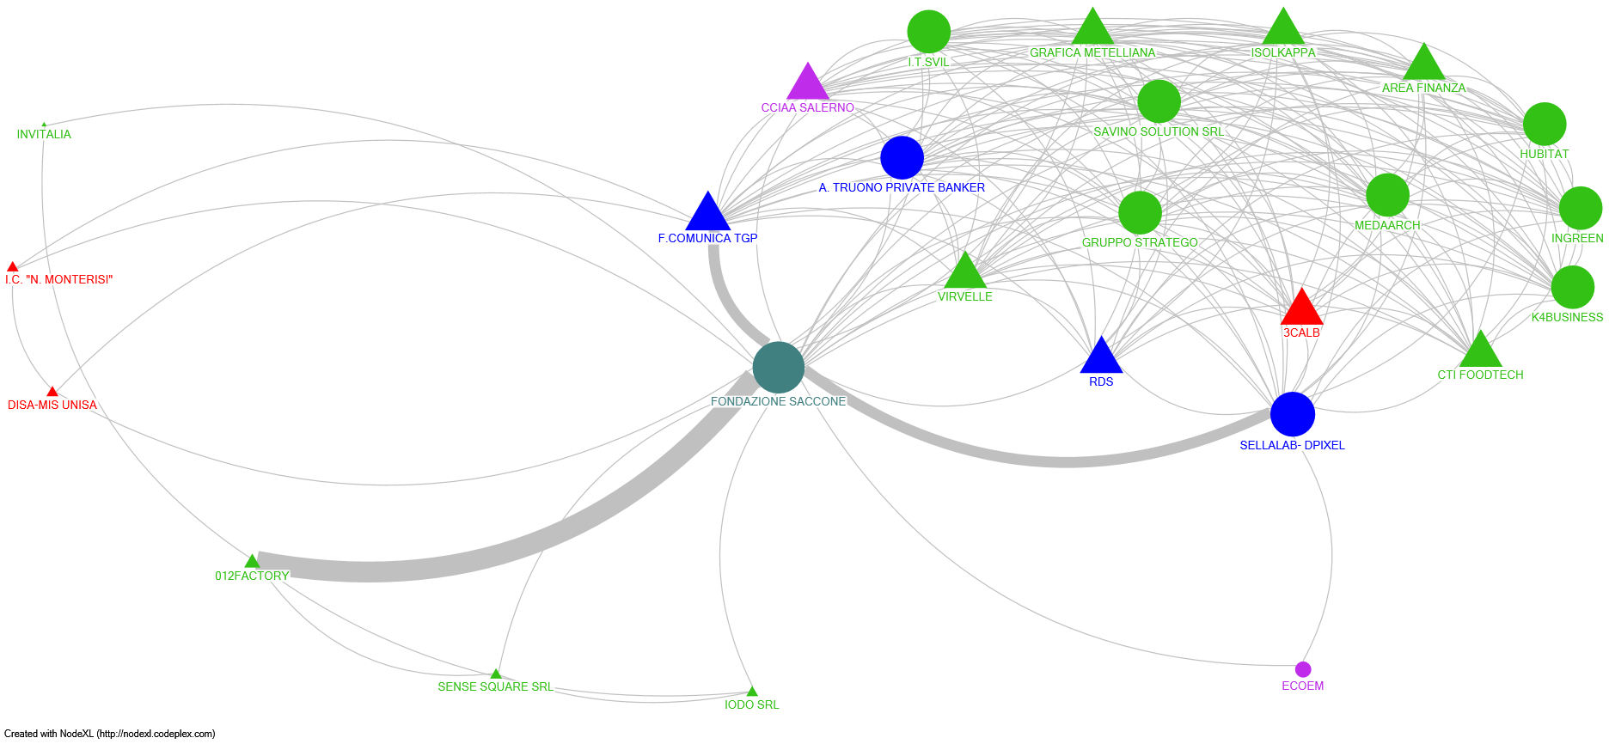
COLLABORATION NETWORKS OVER TIME
2019
2020
2021
2022
Notes:
The same network was then broken down by year: from 2019 year of birth of the network until 2022. It is still the same initial network, but it displays the evolution it has had over the years.

Slide 14
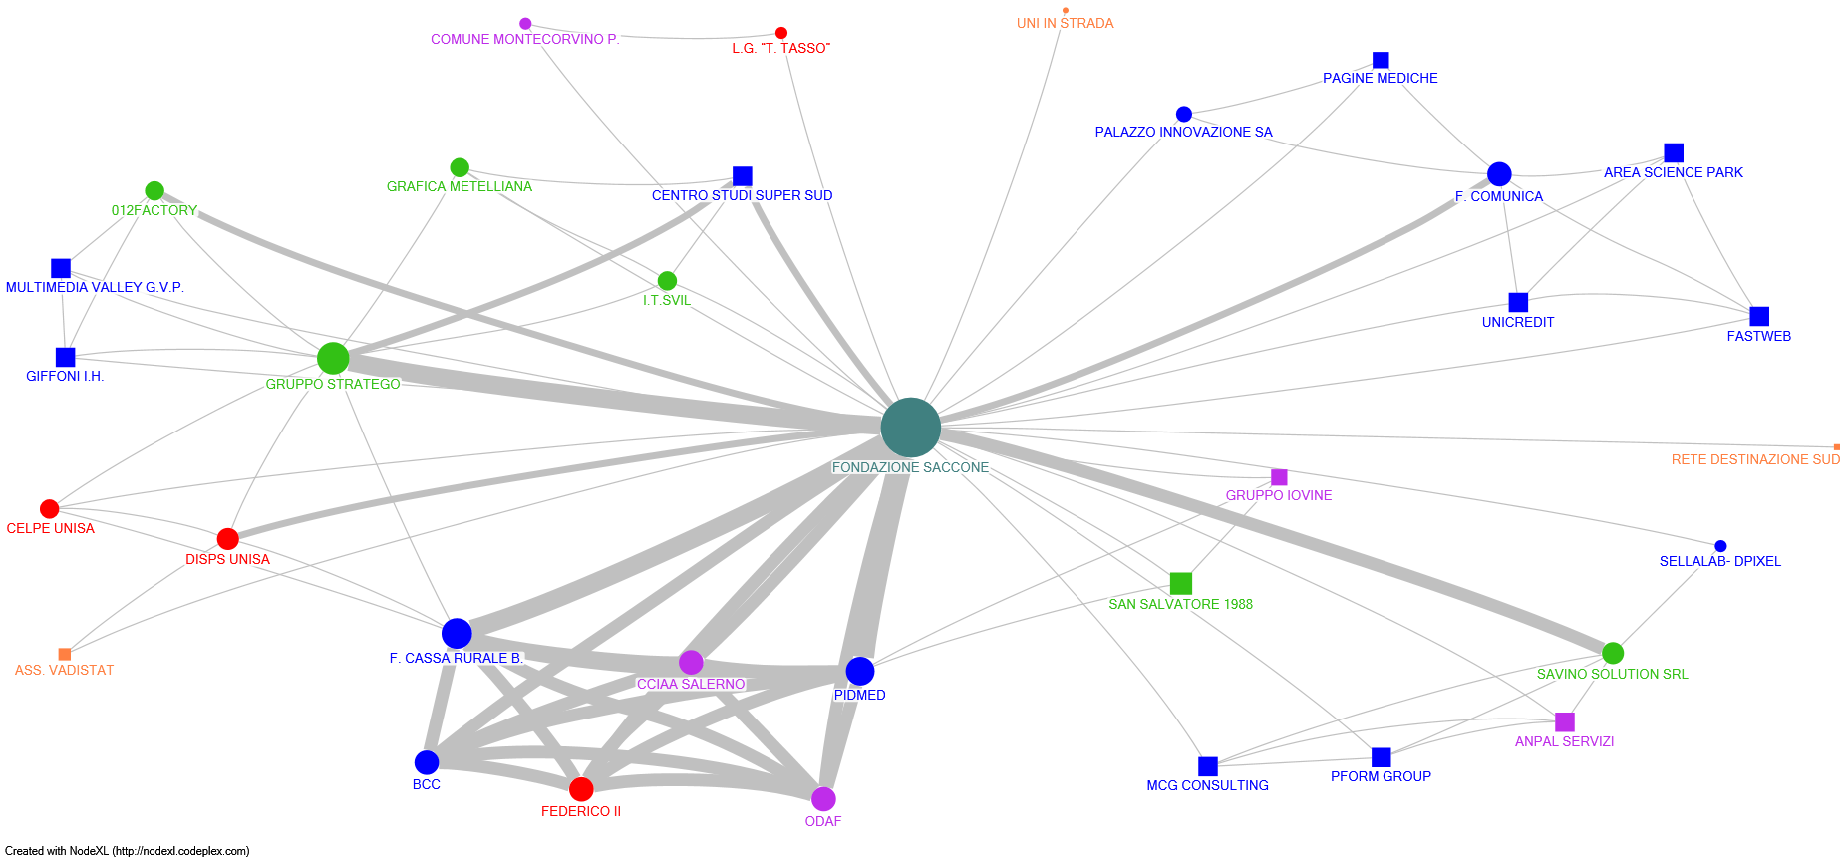
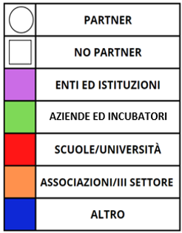
SOCIAL MEDIA NETWORK
Notes:
Leaving the network built starting from the initiatives promoted by the FS, the research work has moved on social Facebook and Linkedin, where through the posts released by the foundation were extrapolated data on territorial stakeholders and collaborations in which the FS was called to participate as a partner. Attention was paid to the presence of entities that had already collaborated with the FS and the birth of new collaborations. Many of these events concern the dissemination of the results of the research that have brought to the attention of third parties with whom new collaborations have been born.

Slide 15
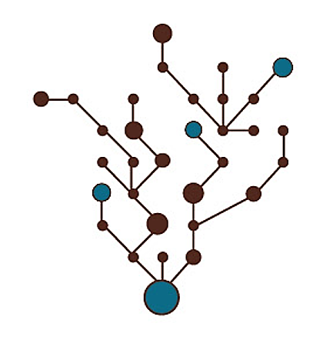
MAIN FINDINGS
From a HUB of competences to a collaborative Network

Slide 16
Thanks for your attention
Notes:
Thanks for your attention

