Slide 1
RESEARCH THEMES, DATABASES AND NETWORK ANALYSIS IN BUSINESS HISTORY
ARS’23 Ninth International Workshop on Social Network Analysis
Ischia Island, Naples, 2-3 May 2023
Alberto Rinaldi (University of Modena and Reggio Emilia, CiMET and RECent)
Erica Salvaj (Universidad del Desarrollo, Santiago, Chile)
Susie J. Pak (St. Johns University, New York, NY)
Daniel S. Halgin (University of Kentucky, Lexington, KY)
Notes:
The study of the bank-industry relationship in Italy has focused on the role of German-style universal banks from their foundation in the 1890s to their abolition in 1936, whereas more recent years are less explored. This paper contributes to fill this gap by analysing the bank-industry relationship in Italy from 1983 to 2017, a time span in which the Italian economy faced several shocks. These were both institutional shocks (the massive privatisation of state-owned enterprises and the reintroduction of universal banking in the 1990s) and sudden shocks (the financial crisis in 2008).

Slide 2
Introduction
This paper discusses the application of Social Network Analysis (SNA) in business history;
Structure of the paper:
Main research themes addressed by the use of SNA in business history;
Some examples of how SNA has been used for macro, meso, and micro analysis:
Macro: national corporate networks in Argentina, Chile, and Italy (1900-2017);
Meso: business networks and permanence of economic elites in Southern Italy (19th century);
Micro: social club memberships, partnership ties, and interlocking directorates of J.P. Morgan & Co. in the early 20th century.
(Tentative) conclusions: new perspectives for the use of SNA in business history.
Notes:
An interlock is the link that is formed between two companies when a person is a director of both.
Interlocking directorates are an important economic institution that provides an opportunity structure for the channeling of information, monitoring, and coordination of market exchange between companies. Firms placed at the centre of the system of interlocks are presumed to have better access to information, better opportunities to spread information and someway a “power” to coordinate the whole network.
The analysis in this paper focuses on primary interlocks, it does not include secondary interlocks. Primary interlocks are used in all international studies

Slide 3
Research themes: the firm’s perspective
Are corporate networks – i.e., networks generated by interlocking directors (IDs) – irrelevant or relevant to corporate governance and interfirm relations?
Irrelevant:
Theory of the managerial control of the firm: control is exercised by management → The board of directors is only an organ of representation (Koenig et al. 1979; Silva et al. 2021);
Relevant:
IDs as a control mechanism: Theory of the hegemony of finance capital (Hilferding 1910) and Kotz’s (1978) “bank control model”: Control of credit flows and, more rarely, part of firm’s equity enables banks to determine firms’ strategy → IDs are a major instrument to enforce this control through the presence of bank fiduciaries on company boards;
IDs as a coordination and communication mechanism driven by convergence of interests: Resource dependence models: restrictions on access to resources and information push firms to create IDs → Firms use IDs to co-opt other organizations with which they are interdependent (Haunschild & Beckman 1998; Hillman et al. 2009; Fohlin 2007, 2012).
Notes:
Zorzini (1925) and Luzzatto Fegiz (1928): high presence of directors of the two largest mixed banks – Banca Commerciale Italiana and Credito Italiano – on the boards of electric power companies; high concentration of the whole corporate system: 2% of directors controlled more than one-third of the total share capital of Italian joint-stock companies.
Important topic in the Italian historiography. However, only few studies have addressed it using the interlocking directorates technique.
Interlocking directorates are a structure for the channeling of information, monitoring, and coordination of market exchange between companies
Despite the relevance of the relationships between banks and industry for the Italian economic historiography, only very few studies have addressed this topic by using the interlocking directorates technique. An interlock is the link that is formed between two companies when a person is a director of both. Interlocking directorates are an important economic institution that provides an opportunity structure for the channeling of information, monitoring, and coordination of market exchange between companies. Firms placed at the centre of the system of interlocks are presumed to have better access to information, better opportunities to spread information and someway a “power” to coordinate the whole network.
The pioneering works by Zorzini (1925) and Luzzatto Fegiz (1928) found in the mid-1920s a high presence of directors of the two largest mixed banks – Banca Commerciale Italiana and Credito Italiano – on the boards of electric power companies and, more generally, a high concentration of the whole corporate system, in which 2 per cent of directors controlled more than one-third of the total share capital of Italian joint-stock companies. More recently, Cohen (1967) and Fohlin (1999) also found that universal banks were at the centre of an entangled network with large firms in modern capital-intensive sectors such as electric power, chemicals, iron and steel, and shipyards. However, Vasta & Baccini (1997) argued that the Italian corporate network was not characterised by such a strong centrality of banks. The location of banks at the centre of the network could be detected in 1911 and even more in 1927, but this was no longer the case in 1936, after the collapse of the universal banks. Moreover, Vasta et al. (2017) argued that Italian capitalism is structured to a remarkable extent on a sizeable and stable system of corporate interlocks that existed in parallel to that centred on the universal banks. They also showed that the influence, at least in Lombardy and some other areas of the North, was exerted by local banks that in turn developed a dense web of ties with industrial firms in both capital-intensive and labour-intensive industries.

Slide 4
Research themes: the director’s perspective
IDs can also be analyzed from the perspective of links between individuals (Mizruchi 1996; Carroll 2010);
The network of IDs is an indicator of the structure of the corporate elite → A dense network is an expression of the cohesion of the elite (and its capability to act in a coordinated way);
Dense networks erect barriers against free riding, as network members can more easily monitor and sanction each other → Therefore, networks impose a certain code of ethics amongst members of the elite → In largely-held joint stock companies IDs can replace ownership as mechanism of control (Windolf 2014).
Notes:
For the period after WW2, Chiesi (1982, 1985) was the first to use of formalized network analysis techniques. This author illustrated the existence in the mid-1970s of a centre of the system inside of which two large poles cohabited, hinged respectively on SOEs and on privately owned enterprises. Chiesi’s analysis also dealt with the relations between banks and industry, observing that the absence of large banks amongst central actors depended on the effects of the 1936 banking law which, by separating the function of the collection of deposits from industrial credit, had rendered it impossible to re-establish those close relations between banks and industries that had so strongly distinguished the period prior to the crisis.

Slide 5
Main results of SNA in business history
The use of SNA in business history has allowed to open new perspectives in the analysis of systems of actors wherein economic action is embedded;
The focus on IDs and corporate networks has revealed to be particularly useful in noticing new – and sometimes surprising – connections among firms (or the lack of them), financial institutions, economic elites and the state;
These have triggered new interpretations of the structures of coordination, control and power in capitalist societies (David & Westerhuis 2014; Sapinki & Carroll 2018).

Slide 6
Macro analysis: national corporate network in Italy
The Imita.db database (http://imitadb.unisi.it):
It is the electronic version of the serial source Notizie statistiche sulle principali società italiane per azioni, edited by Credito Italiano (1906-25) and Assonime (1928-84) → It stores data on:
More than 38,000 companies for nine benchmark years (1911, 1913, 1921, 1927, 1936, 1952, 1960, 1972, 1983);
Almost 300,000 directors of Italian joint-stock companies for the same benchmark years;
More than 100,000 balance sheets for all industrial companies contained in the source;
Fresh results on several aspects of Italy’s economic and business history:
The bank-industry relationship and especially the networks of local banks (Baccini & Vasta 1997; Vasta et al. 2017; Rinaldi & Spadavecchia 2021);
The links between SOEs and with private firms (Rinaldi & Vasta 2012, 2014);
The effects of major institutional shocks, i.e., the nationalization of the electricity industry in 1962 (Rinaldi & Vasta 2005).

Slide 7
Macro analysis: national corporate network in Argentina
The database:
Boardroom composition of the largest 100 firms and 25 banks, including both listed and non-listed firms;
Eleven benchmark years for Argentina (1901, 1914, 1923, 1937, 1945, 1954, 1970, 1980, 1990, 2000, 2010);
Multiple sources of data (year books, repositories, firm information).
Fresh results on several aspects of Argentina’s economic and business history (Lluch & Salvaj 2014):
Argentina evolved into highly fragmented, uncoordinated networks.
Firms’ ownership: from the 1950s MNCs become more relevant in Argentina.

Slide 8
Evolution of the Corporate Network Structure
Argentina (1901-2010)
ARGENTINA
Year | 1901 | 1913 | 1923 | 1937 | 1945 | 1954 | 1970 | 1980 | 1990 | 2000 | 2010
Sample size - Number of firms | 125 | 125 | 125 | 125 | 126 | 128 | 124 | 111 | 125 | 125 | 118
Structure of the network
Number of marginal firms (M) | 18 | 18 | 27 | 19 | 21 | 27 | 21 | 26 | 27 | 21 | 17
M as percentage of total number of firms | 0.144 | 0.144 | 0.216 | 0.152 | 0.166 | 0.211 | 0.169 | 0.234 | 0.216 | 0.168 | 0.144
Isolated firms (I) | 18 | 37 | 32 | 28 | 39 | 37 | 48 | 42 | 73 | 76 | 80
I as percentage of total number of firms | 0.144 | 0.296 | 0.256 | 0.224 | 0.309 | 0.289 | 0.387 | 0.378 | 0.584 | 0.608 | 0.678
I and M as percentage of total number of firms | 0.288 | 0.440 | 0.472 | 0.376 | 0.472 | 0.500 | 0.556 | 0.613 | 0.800 | 0.776 | 0.822
Firms in main component | 104 | 75 | 74 | 83 | 77 | 78 | 64 | 37 | 24 | 6 | 11
Percentage of firms in main component | 83.2 | 60 | 59.2 | 66.4 | 61.1 | 60.9 | 51.6 | 33.3 | 19.2 | 4.8 | 9.3
Ties
Total number of lines | 382 | 324 | 250 | 450 | 340 | 245 | 137 | 144 | 93 | 108 | 60
Total number of lines (main component) | 380 | 314 | 238 | 432 | 326 | 232 | 130 | 100 | 46 | 8 | 22
Number of multiple lines (main component) | 91 | 74 | 36 | 80 | 52 | 37 | 12 | 13 | 8 | 1 | 5
Density (main component) | 0.070 | 0.113 | 0.087 | 0.125 | 0.110 | 0.076 | 0.063 | 0.146 | 0.160 | 0.444 | 0.364
Distribution of Position over Individuals
Number of directors | 737 | 564 | 563 | 637 | 653 | 815 | 884 | 977 | 861 | 786 | 825
Number of interlockers | 126 | 98 | 91 | 122 | 110 | 110 | 81 | 103 | 64 | 70 | 56
Number of big linkers | 49 | 41 | 27 | 46 | 41 | 37 | 18 | 21 | 14 | 16 | 6
Interlockers as percentage of directors | 17.1 | 17.4 | 16.2 | 19.2 | 16.9 | 13.5 | 9.1 | 10.5 | 7.4 | 8.9 | 6.79
Big linkers as percentage of directors | 6.7 | 7.3 | 4.8 | 7.2 | 6.3 | 4.5 | 2.0 | 2.1 | 1.6 | 2.0 | 0.73
Number of board positions | 956 | 738 | 710 | 865 | 844 | 980 | 991 | 1104 | 943 | 876 | 887
Percentage of board positions held by interlockers | 36.09 | 36.86 | 33.52 | 40.46 | 35.66 | 28.06 | 18.97 | 20.83 | 15.48 | 18.26 | 13.30
Percentage of board positions held by big linkers | 19.98 | 21.41 | 15.49 | 22.89 | 19.31 | 13.16 | 6.26 | 5.98 | 4.88 | 5.94 | 2.03

Slide 9
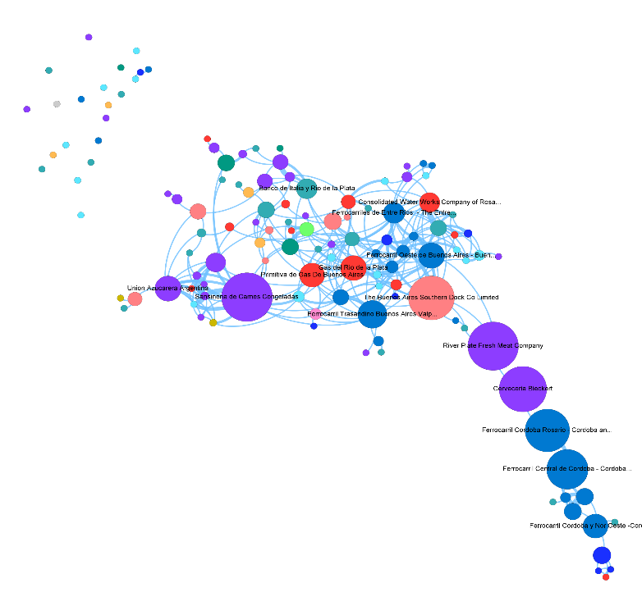
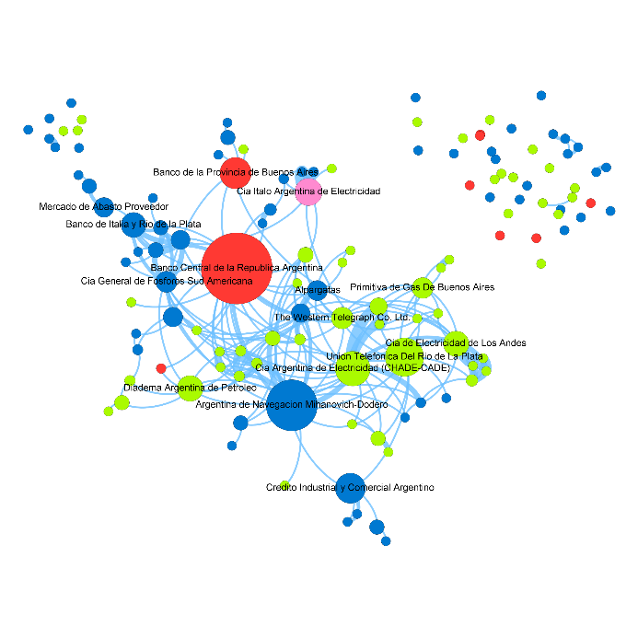
Argentina 1901
Argentina 1945

Slide 10
Macro analysis: national corporate network in Chile
The database:
Boardroom composition of the largest 100 firms and 25 banks, including both listed and non-listed firms.
Six benchmark years for Chile (1901, 1939, 1970, 1988, 1999, 2010)
Multiple sources of data (year books, repositories, firm’s information)
Fresh results on several aspects of Chile’s economic and business history:
Meso level: Divergent trajectories in business structures with Argentina
Chile maintained integration during the whole period; except for 1988 were the network exhibits a higher value of fragmentation
Prevalence of FFs in Chile.

Slide 11
Evolution of the Corporate Network Structure
Chile (1901-2010)
CHILE
Year | 1901 | 1939 | 1970 | 1988 | 1999 | 2010
Sample size - Number of firms | 125 | 125 | 127 | 125 | 125 | 125
Structure of the network
Number of marginal firms (M) | 15 | 25 | 18 | 15 | 15 | 11
M as percentage of total number of firms | 0.120 | 0.200 | 0.142 | 0.120 | 0.120 | 0.088
Isolated firms (I) | 29 | 19 | 11 | 30 | 11 | 13
I as percentage of total number of firms | 0.232 | 0.152 | 0.087 | 0.240 | 0.088 | 0.104
I and M as percentage of total number of firms | 0.352 | 0.352 | 0.228 | 0.360 | 0.208 | 0.192
Firms in MC | 80 | 104 | 116 | 74 | 110 | 110
Percentage of firms in main component | 64.0 | 83.2 | 91.3 | 59.2 | 88.0 | 88.0
Ties
Total number of lines | 397 | 466 | 418 | 303 | 466 | 510
Total number of lines (main component) | 375 | 463 | 418 | 251 | 462 | 505
Number of multiple lines (main component) | 62 | 70 | 44 | 51 | 65 | 111
Density (main component) | 0.117 | 0.086 | 0.062 | 0.092 | 0.076 | 0.083
Distribution of Position over Individuals
Number of directors | 510 | 592 | 447 | 625 | 716 | 601
Number of interlockers | 92 | 135 | 121 | 122 | 177 | 184
Number of big linkers | 44 | 61 | 51 | 42 | 76 | 69
Interlockers as percentage of directors | 18.04 | 22.8 | 27.1 | 19.5 | 24.7 | 30.6
Big linkers as percentage of directors | 8.63 | 10.3 | 11.4 | 6.7 | 10.6 | 11.5
Number of board positions | 689 | 842 | 668 | 816 | 1,008 | 906
Percentage of board positions held by interlockers | 39.33 | 45.72 | 51.20 | 38.36 | 46.53 | 53.97
Percentage of board positions held by big linkers | 25.40 | 28.15 | 30.24 | 18.75 | 26.49 | 28.59

Slide 12
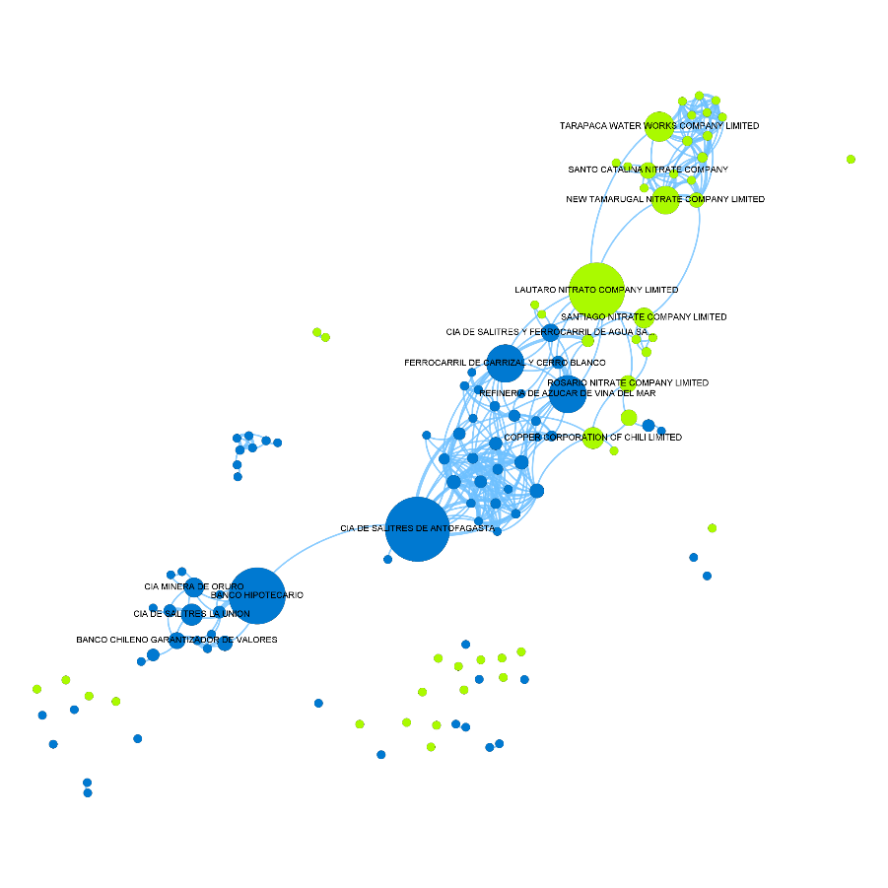
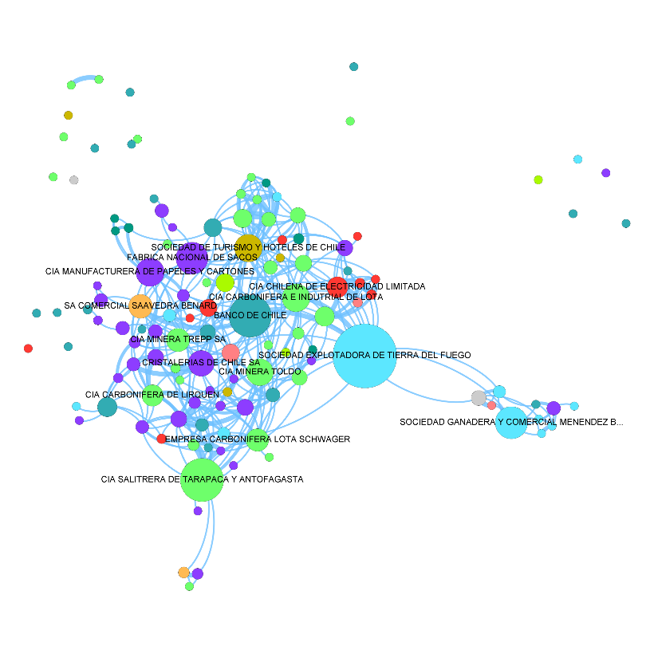
Chile 1901
Chile 1940

Slide 13
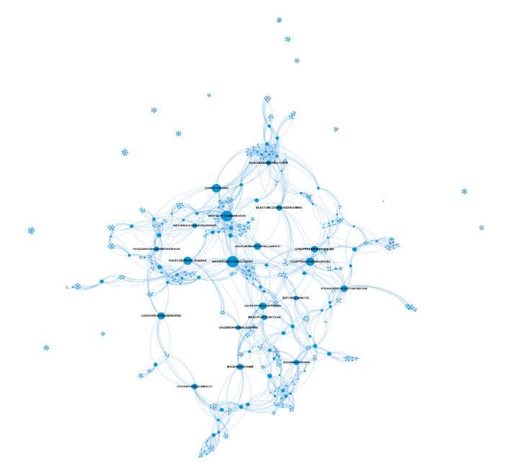
National corporate networks in 2010: Argentina (left), Chile (centre) and Italy (right)

Slide 14
Meso analysis: business networks and economic elites in Southern Italy
The IFESMez database:
The primary source for this database is Mercantile Court archival funds (from 1883 on, Civil Court) at the Naples State Archive:
Data are collected from official documents (memoranda of association, balance sheets, appointments of directors, minutes of general meeting, etc.) provided to the courts by firms of any legal form. The dataset includes all firms legally registered in Naples; firms that are registered elsewhere but operate in Naples; and firms that are linked to firms in Naples through common shareholders, directors etc.;
Archival data have been integrated with information from other sources (grey literature, publications);
The database contains information about 3,500 firms and 28,000 individuals (shareholders, partners, directors, syndics, managers) for the 1800-1913 years;
New findings on business networks and the persistence of economic elites in Southern Italy well over Italy’s unification in 1861 → Pivotal role of local utility firms and financial firms to co-opt outsiders (Schisani & Caiazzo 2016; Schisani et al. 2021).

Slide 15
Micro: social club memberships, partnership ties, and interlocking directorates of J.P. Morgan & Co. in the early 20th century
Question: What role do social clubs play in the facilitation of cooperative relationships between economic actors?
Following the tradition of Padgett & Ansel (1993), the case of J.P. Morgan & Co.’s strategic tie formation focuses on the relationship between the social and economic ties correlating partnership capital and syndicate participation with social club memberships (Pak 2013).
The value of social clubs is studied in both partnerships or internal firm dealings and, through the analysis of rare syndicate data, external interactions.

Slide 16
Micro: social club memberships, partnership ties, and interlocking directorates of J.P. Morgan & Co. in the early 20th century
Data Sources:
Direct population data from the Social Register, New York published by the Social Register Association for the years 1897, 1905, 1910, 1915, 1920, 1925, 1930, 1935, and 1940; comparable years for the Social Register, Philadelphia;
Articles of copartnership, 1894-1914, ARC 1195, Box 1; Articles of copartnership: J.P. Morgan & Co., 1916-1939, Morgan Firms Papers, ARV 131798, Box 1, Morgan Firm Papers, Pierpont Morgan Library and Museum (PML);
J.P. Morgan & Co. Syndicate Books, ARC 108-ARC 119, PML.

Slide 17
Micro: social club memberships, partnership ties, and interlocking directorates of J.P. Morgan & Co. in the early 20th century
The social status of partners benefited from club memberships because it affected internal firm cohesion and the economic structure of the partner hierarchy.
Accounting for the total number of clubs, we found that partners were rewarded by greater partnership capital ownership in the following five-year period not just for joining social clubs randomly but after joining the inner circle of clubs popular with firm partners.
Increases in social club memberships with Morgan partners were also associated with increases in the amount allotted in the syndicates by external firm cohesion, even when accounting for common board memberships and education.
Did the Morgans tend to work more with participants with whom they had overlaps in social clubs? The answer is yes.

Slide 18
Micro: social club memberships, partnership ties, and interlocking directorates of J.P. Morgan & Co. in the early 20th century.
The general significance of private social club associations for the study of economic cohesion takes place in the context of unsuccessful efforts to regulate private banking in the financial sector—including other banks, both private and commercial, and client firms, such as railroads—during the Progressive era of U.S. American history;
Private elite men’s social clubs provided opportunities for financial leaders to interact and were signals of members’ legitimacy that helped shape and govern economic transactions.

Slide 19
(Tentative) conclusions: new perspectives for the use of SNA in business history
Business historians can use SNA to engage with more recent debates, notice new connection (or the lack of them), and provide original interpretations;
One of the most outstanding results in this field is the weakening of national directors’ networks since the 1980s (David & Westerhuis 2014):
What are the causes of this decline?
Is this decline leading to the end of national corporate networks (and loss of a national corporate elite) (Mizruchi 2013) or to their recomposition into “small words”? (Kogut 2012)?
Other possible areas of investigation → new networks:
Emergence of transnational networks;
Regional and and local networks;
Networks created by joint-membership of think-tanks, policy-planning groups, university boards, employers’ associations, philantropic associations, etc.

